Slide 1
FHFA’s Request for Input on Appraisal Related Policies, Practices, and Processes
Edward Pinto (pintoedward1@gmail.com), Director
Tobias Peter (Tobias.Peter@AEI.org), Director of Research
AEI Housing Center
AEI.org/housing
February 26, 2021
Link to AEI HMIs:
https://www.aei.org/housing/housing-market-indicators/
We grant permission to reuse this presentation, as long as you cite as the source:
AEI Housing Center, www.aei.org/housing.

Slide 2
AEI’s In-depth Study into Alleged Racial Bias by Appraisers on Mortgage Loans
Full report may also be found at: https://www.aei.org/economics/special-briefing-on-appraiser-bias/

Slide 3
How Common Is Appraiser Racial Bias?
An Analysis Using Big Data to Inform as to Whether It Is Common or Uncommon that an Appraiser’s Knowledge of an Applicant’s Race Results in Valuation Bias
Edward Pinto (pintoedward1@gmail.com), Director
Tobias Peter (Tobias.Peter@AEI.org), Director of Research
AEI Housing Center
Working Report
AEI.org/housing
January 19, 2021
Link to AEI HMIs:
https://www.aei.org/housing/housing-market-indicators/
We grant permission to reuse this presentation, as long as you cite as the source:
AEI Housing Center, www.aei.org/housing.

Slide 4
Recent Reports Alleging Racial Bias by Appraisers on Mortgage Loans
New York Times examples*
  $135,000 or 29% difference (Jacksonville FL - appraisal 1: $330,000, appraisal 2: $465,000)
  $40,000 (% unknown) difference (Hartford, CT suburb)
  $160,000 or 24% difference (Los Angeles - appraisal 1: $500,000, appraisal 2: $660,000)
Denver News Channel 7 example**
  $145,000 or 26% (Denver, CO – appraisal 1: $405,000, appraisal 2: $550,000)
Chicago Sun Times example***
  $62,000 or (Chicago, IL – appraisal 1: $278,000, appraisal 2: $340,000)
Of four examples with sufficient data, appraisal 1 came in an average of about $126,000 or 25% lower than appraisal 2.
Claims of bias were based on an allegation that a human appraiser was aware of the applicant(s)’ race either from a meeting or photos or other items in the home which indicated race, and as a result, the appraiser underestimated the property’s value.
Allegations commonly occurred in predominantly White neighborhoods.
The implication is that intentional and perhaps unintentional appraisal bias is commonplace and the valuation gaps are large.
While the facts alleged may well be true, any policy response must be based on whether the cases are the result of “bad apple” appraisers or systemic racial bias.
A literature search found no statistical analysis of this type of claim.
Using big data we conduct the first analysis into whether the alleged practices of intentional racial bias, along with unintentional bias, are common or uncommon.
* https://www.nytimes.com/2020/08/25/realestate/blacks-minorities-appraisals-discrimination.html
** https://www.thedenverchannel.com/news/local-news/an-unconscious-bias-biracial-denver-couple-says-they-faced-discrimination-on-home-appraisal
*** https://chicago.suntimes.com/2020/10/7/21493755/chicago-home-appraisal-black-race-homeowners

Slide 5
We Asked the Collateral Risk Network (CRN) to Survey Appraisal Management Companies and Lenders
Why: our data consist of appraisals on transactions that actually closed, thus we need to evaluate whether our set suffers from selection bias as discrimination might occur with respect to appraisals not used in loan closings.
The question is: how likely is that Review of Valuation (ROV) requests are received and what happens after an ROV is made? Here are relevant results:
Conclusions:
  Items noted in red are not unique to claims of racial or ethnic bias, but are common to all ROVs.
  An ROV is rare (2.5%-3% incidence), ROVs are related to race or ethnic bias are also rare, and an ROV is a condition precedent to a second appraisal, which itself is relatively rare (about 10%-20% incidence).
  Based on the survey, we may conclude that our data set, consisting entirely of closed loans, does not suffer from a significant level of selection bias.
 |  | AMC | Lenders
Frequency of Review of Valuation (ROV) requests: |  | Insufficient data (only 1 response, as AMCs generally do not see ROV requests) | 1st survey- 2.5% (median for 12 responses)
 |  |  | 2nd survey- 3% (median for 8 responses)
Most common reasons for a ROV (where one is given): |  | 1. Poor selection of comps | 1. Poor selection of comps
 |  | 2. Recent Improvements not noted | 2. Sq. Ft. incorrect
 |  | 3. Sq. Ft. incorrect | 3. Recent Improvements not noted
Regarding ROVs involving racial or ethnic bias: | Never | 58% | 63%
 | <10% | 42% | 37%
When you do get an ROV, how many get escalated to a second appraisal? | Never | 0 (0%) | 2 (25%)
 | <10% | 17 (89%) | 4 (50%)
 | 10-30% | 2 (11%) | 2 (25%)
 | >30% | 0 (0%) | 0 (0%)
How many contracts get renegotiated? | Never | 3 (17%) | 0 (%)
 | <10% | 9 (50%) | 5 (71%)
 | 10-30% | 5 (28%) | 1 (14%)
 | >30-60% | 0 (0%) | 1 (14%)
 | >60% | 1 (6%) | 0 (0%)
Are ROVs more common on refinance or purchases? |  | 68% refi | 63% refi

Slide 6
Home Mortgage Disclosure Act Data for 2018-2019 (HMDA) and HUD Data for 2019-2020 Seemingly Confirm That Selection Bias Is Low
HMDA, a virtual census of institutional loan app data, covered >8 million applicants.
HUD data:
  There is no national appraisal discrimination complaint database. Given HUD’s fair housing role, it does receive appraisal bias complaints. In 2019 and 2020 there were 3 and 6 respectively.
Conclusions:
  HMDA loan denial rate on refis is 16% for White applicants and 26% for Black applicants; denial rate on purchase loans is lower for both White and Black applicants.
    The main reasons for Black denials are credit history and DTI.
    Collateral is noted as a denial reason less for Black applicants than White ones and perceived or alleged bias would be one of a number of potential reasons for a collateral denial.
    Based on HMDA data, the potential for bias by an appraiser is small, since it would be a percentage of a percentage of a percentage.
  Since HMDA is consistent with the results of the CRN survey and since HUD receives relatively few complaints, notwithstanding media coverage of appraiser bias, we may conclude that our data set, consisting entirely of closed loans, does not suffer from a significant level of selection bias.
  * https://www.washingtonpost.com/realestate/for-black-homeowners-a-common-conundrum-with-appraisals/2021/01/20/80fbfb50-543c-11eb-a817-e5e7f8a406d6_story.html
 |  | White | Black
Refi | Total Applications | 4,995,603 | 614,394
 | % of Application Denied | 16% | 26%
 | % Denial Reason is Collateral | 17% | 14%
 | % Denial Reason is DTI or Credit History | 49% | 54%
Purchase | Total Applications | 6,065,075 | 782,255
 | % of Application Denied | 8% | 17%
 | % Denial Reason is Collateral | 13% | 8%
 | % Denial Reason is DTI or Credit History | 56% | 66%
Note: Data for 1st lien, 1-unit, owner-occupied homes only. Excludes I/O, balloons, or neg. am. loans. “Denial “for principal denial reason only.
Source: HMDA 2018 & 2019

Slide 7
Analytical Framework
Refi
Human appraisal
GSE appraisal waiver based on evaluating value set forth in application
(They are unbiased as race is not taken into account)
CRN survey suggests this is infrequent
Alleged biased 1st appraisal based on appraiser having knowledge of applicant’s race. Media allegations generally occurred in White neighborhoods.
Unbiased 1st appraisal
Outcomes in blue are what we observe in the data and what are used for the analysis.
We don’t know the frequency
CRN survey suggests this is infrequent
Consumer does not request ROV but proceeds with an alleged biased 1st appraisal
The more biased appraisals there are and the larger the bias, the easier it will be to detect them in the results – and vice versa.
Consumer accepts 1st appraisal and loan does not get made
Requests ROV for racial bias
Consumer proceeds with an alleged biased 1st appraisal
Consumer accepts 1st appraisal and loan does not get made
Yields a presumably unbiased 2nd appraisal
We don’t know the frequency
CRN survey suggests this is infrequent
CRN survey suggests this is infrequent

Slide 8
We Use Big Data to Evaluate the Likelihood of Racial Bias by an Appraiser
The AEI Housing Center has assembled the National Housing Market Database (NHMDB), which uses and connects many different datasets.
  Most in-depth resource for key housing data and trends.
  Accurate, timely, and in-depth coverage of purchase trends.
  Connects the dots for many housing indicators, yielding the most comprehensive analysis of the housing market.
  Its integrated structure is uniquely suited to study countless questions.
  Here we apply the NHMDB to help shed light on the question: Is there intentional or unintentional racial bias by appraisers?
    We are able to identify whether the transaction had a human appraiser or a GSE appraisal waiver using a computer generated value.
      The waiver value is unbiased, as neither race nor any other borrower characteristic is used that could be correlated with race is used in generating the value.
    We use the race neutral Automated Valuation Model (AVM), where neither race nor any other borrower characteristic is used that could be correlated with race is used in generating the value.
    The AVM controls for non-racial factors that affect home value, leaving the race dummies to pick up any racial effects.
    AVMs allow us to statistically test bias assertions by objectively assessing previously performed human appraisals and appraisal waivers.
  A literature search found no statistical analysis of this type.
    This study is based on 243,000 appraisals (of which 59,000 are GSE appraisal waiver cases & 22,000 GSE human appraisals), & 2,600 group match cases originated in 2018 & 2019.
  Unintentional bias may have a disparate impact, but it must be demonstrated that a challenged practice involving racial bias is the substantial cause of the disparate impact.
  Using computer generated property values, we used big data to look for bias of the type alleged in the media and racial bias that might result in a disparate impact allegation.
This Working Report presents preliminary results and we welcome comments.

Slide 9
Using Big Data to Evaluate the Presence of Appraiser Bias
NHMDB data used in performing this analysis include:
  Public records
  Automated Valuation Models (AVM)
  National Mortgage Risk Index using agency loan data, including use of appraisal waivers
  Home Mortgage Disclosure Act (HMDA) data
Our main focus is on refinance loans:
  Refinance loans lack an arm’s length transaction, potentially providing more of an opportunity to exercise racial bias.
  Purchase loan appraisals are highly anchored to the sales price and therefore tend to not come in below the sales price.* This makes them useful as a check, since they provide less of an opportunity and potential to exercise racial bias.
  Thus, deviations due to bias, if present, should be larger for unanchored refi valuations compared to anchored purchase valuations.
  FHA purchase loans have a unique double anchor, which is useful for a natural experiment:
    The 1st anchor is to sales price and the 2nd to a statutory maximum LTV of 96.5%.
    Also, an average LTV of around 95% for groups being compared, which means even a small gap between the sales price and appraised value would require a price renegotiation with the seller.
    * Contract Price Confirmation Bias: Evidence from Repeat Appraisals

Slide 10
Methodology
We use 2 different approaches, to see if on average there is a value difference (or a gap) between refinance loan appraisals for Blacks and Whites, in order to evaluate the existence of bias, especially as it relates to the alleged practices.
Automated Valuation Model (AVM) approach (N-count = 243,000 loans)
  We regress the log Dec-2017 AVM, month of origination dummies, census tract fixed effects, and a dummy variable for minority status on the log property value.
    An AVM provides a neutral control for neighborhood and home characteristics.
    Lacks “knowledge” of applicant’s race.
    We filter out properties with extreme outliers in home characteristics.
  Our analysis is enhanced by running it separately for loans using human generated appraisals vs. waivers confirming the self-evaluation or arms-length transaction price through a computer generated model (the AVM noted above is independent of the self-evaluation value, the arms-length transaction price, and the waiver value).
    The goal is to determine whether an alleged practice (such as racial bias based on knowing whether an applicant is Black from a meeting or interior items (i.e. photos, art, or books) occurs more frequently on Black refi valuations by humans.
    A second goal is to test for unintentional racial bias against Blacks on refi valuations by humans that has a disparate impact and is the substantial cause of the disparate impact.
  Hedonic approach is used to check the AVM approach:
    We replace the AVM with house characteristics (sq. footage, lot size, year built, and census tract).
Group approach (N-count = 2,600 groups):
  Identify groups of homes that are identical based on external characteristics (same census tract, home type, sq. footage, lot size, year built, # of baths, and land use code), within 1,650 ft of each other (median: 200 ft), and owned by households of different racial backgrounds.
    Rules out challenged practices such as comp selection, neighborhood effects, and AVM bias as an explanation.
  We regress a set of dummies for minority status and month of origination on the log property value. The group of homes are treated as fixed effects.
We define the following non-overlapping groups (N-counts):
 | AVM/Hedonic | GSE Human | GSE Waiver | Group
White (defined as non-Hispanic White) | 212,935 | 53,397 | 21,539 | 3,563
Black (defined as non-Hispanic Black) | 30,435 | 5,393 | 1,391 | 2,810
Note: 2% of Hispanics identify as Black Hispanic. These loans are excluded from this analysis.

Slide 11
Note on Interpreting the Results
Purchase loans are arm’s length transactions between consumers. Due to anchoring to the sale price, the opportunity for racial bias from appraisers is low to non-existent.
  The consumers establish the true price of the asset, including quantifying the impact on price of the current state of improvements, upkeep, or decoration (unobservable factors). A computer model can only approximate these items, as it is limited by data availability.
We use a computer generated AVM as a control for home quality, thus unobservable factors will be present in both our purchase and refi analysis. Due to anchoring, purchase results can serve as benchmark on the magnitude of these unobservable factors.
Results for both approaches found similar gaps for both refinance and purchase loans, thus we are able to attribute the refi loan gaps to unobservable factors rather than bias.
Below we compare results for refi and purchase loans using the AVM approach. While there is a modest gap between Blacks and Whites for refis, a slightly larger gap exists for purchase loans. As noted, we compare refis to purchase loans to account for unobservable factors. It appears Blacks on average receive slightly higher appraisals than Whites.
The Group approach, by its design, also provides a compelling means to determine whether racial bias exists. However, it also cannot fully eliminate all unobservable factors.
  Due to small n-sizes, we report these findings second. (By mid-2021 we expect to be able to add another year of data, growing our n-sizes. This will add to the utility of this approach.)
Due to space concerns, the following slides do not explicitly report the gap between Blacks and Whites refinance loan appraisals after accounting for unobservable factors (red) leaving readers to do so on their own.
AVM Approach | Gap between Blacks and Whites | Gap between Blacks and Whites after accounting for unobservable factors
1. For refinance loans only | -0.7%*** | 0.0 ppt.
2. For purchase loans only | -0.7%***
Note: The results are differences in property value relative to Whites. *** denotes significance at the 1% level. Data for this approach are limited to property value $100,000-$1,000,000, Year built between 2000-2019, Lot sizes of 2,000-20,000 sq. ft., and Building area of 800-3600 sq. ft.

Slide 12
AVM Approach Results for Refinance Loans
The media reports all had a common challenged practice: the human appraiser knew the applicant was Black by having met the applicant or from photos in the home and rendered a biased opinion of value that was below the property’s correct value.
The race neutral AVM approach was applied to valuations on: 1. refinance loans generally, 2. purchase loans, and 3. refinance loans with either a human appraisal or a waiver.
  #1 (refinance loans only) includes instances where biased refi valuations have been rendered.
  #2 (purchase loans only) would be much less influenced by bias due to anchoring to the sale price by human appraisers.
  #3. a. (waiver only) has lack of “knowledge” of race and interior condition, or the potential for bias in the selection of comps and should be free of racial bias due to the common practice noted above.
Our results indicate that for #2 (purchase loans) and #3.a. (non-human valuations), Blacks had nearly identical valuation gaps as Whites (-0.8% and -0.5% respectively), as #1 (-0.7%).
Thus we conclude allegation that knowing the race of the applicant results in racial bias by appraisers on refinance loans is uncommon and not systemic. This same analysis supports the conclusion that unintentional bias based on race is also uncommon and not systemic.
AVM Approach | Gap between Blacks and Whites
1. For refinance loans only | -0.7%***
2. For purchase loans only | -0.7%***
3. Limited to refinance loans with an Appraisal/Waiver Flag (GSE only) | -0.7%***
a. Waiver only | -0.3%
b. Appraisal only | -0.8%***
Note: The results are differences in property value relative to Whites. *** denotes significance at the 1% level. Data for this approach are limited to property value $100,000-$1,000,000, Year built between 2000-2019, Lot sizes of 2,000-20,000 sq. ft., and Building area of 800-3600 sq. ft.

Slide 13
AVM Approach: Robustness Checks
 | Gap btw. Blacks and Whites
AVM Approach for refinance loans | -0.7%***
Check 1. AVM Approach for refinance loans but using quantile regression (median value) | -0.7%
Check 2. AVM Approach for refinance loans but limiting to properties with values between the 20th and 80th percentile at the census tract level | -0.4%***
Check 3. AVM Approach for refinance loans but adding controls for FICO bucket, income, CLTV bucket, and the # of borrowers | 0.4%**
Check 4. Hedonic approach for refinance loans | -2.3%***
Check 5. Hedonic approach for purchase loans | -2.4%***
Note: The results are differences in property value relative to Whites. ** denotes significance at the 5% level and *** at the 1% level. Data for these approaches are limited to property value $100,000-$1,000,000, Year built between 2000-2019, Lot sizes of 2,000-20,000 sq. ft., and Building area of 800-3,600 sq. ft.
Checks 1 &2 focus on the impact of outliers, as the anecdotal value gaps averaged 25% and indicate that the AVM Approach results are very robust (that is, remain valid under different assumptions, parameters and initial conditions).
Check 3, which controls for certain borrower characteristics, eliminates the small gap between Blacks to Whites (now a small positive gap).
  Generally, higher income, higher FICO, lower CLTV, and 2 borrowers mean a slightly higher appraisal.
  The results are also generally robust for different states, but n-counts are often too small for a systematic analysis.
Checks 1-3: the gaps for refinance loans likely reflect unobserved property or location characteristics that are not captured in the AVM.
Checks 4 and 5 yields a Black-White gap of -2.3% on refinance and -2.4% on purchase loans. Racial discrimination is unlikely on purchase loans due to sale price anchoring.
Checks 1-5 support our conclusion that the common challenged practice of knowing the race of the applicant results in racial bias by appraisers on refinance loans is uncommon and not systemic. They also support the conclusion that unintentional bias based on race is also uncommon and not systemic.
More robustness checks are provided in the appendix.

Slide 14
Group Approach Results
Group Approach | Gap between Blacks and Whites
1. For refinance loans only | -0.4%
2. For purchase loans only | 0.0%
Note: The results are differences in property value relative to Whites. The results are not statistically significant. Data for this Approach are limited to homes built between 1950 and 2019 and 1-unit SF, condos, townhomes, or PUDs within 500m of each other (median is 200 ft).
This approach looks at two or more identical homes, so as to reduce the possibility for variation between the groups.
  This reduces the likelihood that variation in selected comparable sales, differences in racial make-up of comparable locations, & location within a neighborhood affect the result.
The Group approach, by its design, provides the most compelling evidence regarding the existence of racial bias.
The Group approach has results that are quite close to the AVM approach for refinance loans and there is only a small difference to purchase loans, for which biased appraisals are unlikely. It also supports our earlier conclusions that intentional and unintentional appraiser bias based on race is uncommon and not systemic.
  We ended up with around 2,600 home groups with owners of a different race.
  The results seem to hold for townhomes or condos only, but n-counts are fairly small.
  There is no statistically detectable difference between Waivers and Appraisals for identical homes, but n-counts again are fairly small.

Slide 15
Refi Waiver-Appraisal Gap between Whites (Control Group) and Blacks
The Gap of a Human Appraisal Relative to a Waiver | Using AVM Approach to Measure Gap | N-Count (Appraisal) | N-Count (Waiver)
White (control group as presumably unbiased on race) | -0.8%*** | 45,155 | 19,987
Black | -1.4% | 4,422 | 1,271
Note: Borrower controls are FICO and LTV buckets, the number of borrowers, and income. *** denotes significance at the 1% level. Data are limited to property value $100,000-$1,000,000, Year built between 2000-2019, Lot sizes of 2,000-20,000 sq. ft., and Building area of 800-3,600 sq. ft. They are also limited to GSE borrowers with CLTVs <= 80% since waivers have an eligibility criterion.
Here we examine the gap within the each group between the refi human appraisal and the Waiver.
  Whites with a human appraisal get 0.8% lower value than Whites with a refi waiver and this result is highly statistically significant (at 1% level).
    Whites serve as the control group because their appraisals should not be biased and the Waiver is in theory color blind.
  Blacks with a refi human appraisal get 1.4% lower value than Blacks with a refi waiver appraiser. However, this result is not statistically significant at the 5% level, with a confidence range of +0.3% to -3.2%.
  The difference between the White and Black groups is 0.6%, basically the same as for the AVM and the Group approaches.
This result further supports our conclusion that intentional and unintentional racial bias by appraisers on refinance loans is uncommon and not systemic.

Slide 16
FHA Purchase Transactions: A Unique Natural Experiment to Evaluate Bias
FHA purchase appraisals are helpful as a check because they are prone to anchoring in two ways:
  Sales price as usual.
  Also prone to LTV anchoring due to the statutory LTV limit of 96.5%.
There is another helpful characteristic: an average LTV of 95.23%, only slightly below the statutory maximum 96.5%.
As the chart below demonstrates:
  FHA purchase loan median LTV equals 96.5% for all listed groups.
    Since 73% of FHA loans are at the cap, the median LTV equals the cap.
  FHA purchase loan mean LTVs are all in a tight range relative to median LTVs (White and Black applicants have a 0.48% mean LTV difference).
 | LTV of FHA Purchase Loans
 | # of obs. | Median | Mean
White | 375,508 | 96.50 | 95.04
Black | 92,985 | 96.50 | 95.52
Note: Data cover an estimated 99% of the agency market. Source: AEI Housing Center National Mortgage Risk Index.

Slide 17
FHA Purchase Transactions: a Natural Experiment to Evaluate Bias (Cont’d)
 |  | Gap btw. Blacks and Whites | # of observations
Purchase | AVM Approach (all loan types) | -0.7%*** | 299,930
 | FHA only | 1.0%*** | 35,070
Refi | AVM Approach (all loan types) | -0.7%*** | 243,370
 | FHA only | -0.3% | 30,992
Note: The results are differences in property value relative to Whites. *** denotes significance at the 1% level. Data for this Approach are limited to property value $100,000-$1,000,000, Year built between 2000-2019, Lot sizes of 2,000-20,000 sq. ft., and Building area of 800-3600 sq. ft.
The results for FHA purchase loan appraisals, which involve substantial numbers of Black applicants, provide additional support for the existence of small appraisal valuation gaps, which cannot be attributed to racial bias (the positive gap for FHA purchase loans to Blacks may be due to the larger seller concessions allowed under the FHA program compared to conventional loans and which tend to be used more in low-income areas. Such concessions are absent on refis).
  As noted earlier, there is minimal to no difference between White and Black LTV levels.
  There are two outcomes that would result from bias, both of which are unlikely to occur.
    A biased lower valuation for Blacks, which if present in practice, would result in the frequent renegotiation of purchase contracts to a lower price, since the value does not support the loan amount and there is little LTV room. However, this would work to the benefit of the home buyer; and the CRN survey indicates renegotiations are infrequent.
    To display a bias, the appraiser abandons the tendency to anchor to both the purchase price and a key LTV level, yet the dollar difference here is so small that it itself would be red flag and would create a notable headache for the appraiser over the small amount.
The results for refinance loans are fairly similar to purchase loans, and as noted above, the results for purchase loans more or less rule out significant bias.
Therefore this experiment also supports our conclusions.

Slide 18
A Further Robustness Test: Refi Appraisal Gap by Neighborhood
Under this test, we create census tract groups based on shares of Black residents and then compare gaps for tracts with <=25% and >25% Black residents.
This is an important test as the media allegations of racial bias commonly occurred in predominantly White neighborhoods.
The gaps for tracts with <=25% and >25% Black residents are virtually identical (-0.6% and -0.7% respectively), both of which are nearly the same gap as shown on Slide 9: -0.7%).
This result adds further support to our conclusion that the alleged practice of knowing the applicant’s race results in racial bias by appraisers on refinance loans is uncommon and not systemic.
It also supports the conclusion that unintentional appraiser bias based on race is also uncommon and not systemic.
Black resident share of census tract | Gap btw. Blacks and Whites | # of White observations | # of Black observations
All | -0.7%*** | 212,935 | 30,435
<= 25% | -0.6%*** | 205,480 | 19,639
> 25% | -0.7%** | 7,198 | 10,774
Note: Regression is the AVM refi approach and data are limited to property value $100,000-$1,000,000, Year built between 2000-2019, Lot sizes of 2,000-20,000 sq. ft., Building area of 800-3600 sq. ft. We only use human appraisals, waivers are excluded. Minority share of census tract is defined as the share of Black people residing in a tract. ** denotes significance at the 5% level and *** at the 1% level.

Slide 19
Pro-actively Identifying or Defending against Appraiser Bias
Regulators, Appraiser Management Companies (AMCs), appraisal firms and mortgage lenders would be able to replicate our methodology and use it to pro-actively identify and root out cases of appraiser racial or ethnic bias. It could also be used to defend against claims of appraiser racial or ethnic bias.
Using our methodology one would be able to confirm the presence or lack of a statistically significant pattern of bias being experienced by the protected class, by rendering outcomes directly comparable between the protected and non-protected classes.* Should the result show no statistically significant difference in the valuation outcomes between a protected class and a non-protected class, one could conclude there was a lack of statistically significant racial bias. These results would also be usable as a valid defense to any disparate impact liability.
Regulators and individual firms likely have access to even more data than was used in our analysis:
  Access to the appraiser and appraisal firm’s name,
  Access to all loan applications, regardless of disposition,
  Access to all complaints and review of valuation requests and their disposition, regardless of race or ethnic origin.
  * See Comment Letter on HUD’s Implementation of the Fair Housing Act’s Disparate Impact Standard
19

Slide 20
Conclusion: How Common Is Appraiser Racial Bias?
We set out to statistically examine the level of racial bias in human performed appraisals.
The CRN survey of lenders and AMCs suggest that Reconsiderations of Value (ROVs) are infrequent, as are reappraisals based on an ROV. Further, ROVs with an allegation of racial bias on 1st appraisal are also infrequent.
The CRN survey and HMDA data both support the conclusion that our data set, consisting entirely of closed loans, does not suffer from a significant level of selection bias.
Thus, statistically analyzing big data on closed loans can contribute to determining the presence and levels of racial bias by appraisers.
The more biased appraisals there are and the larger the under-valuation, the easier it would be to detect them in the results – and vice versa.
While a claim of disparate impact does not need to demonstrate intent or knowledge, any challenged practice must be shown to be the substantial cause of the disparate impact.
Our analysis looked for evidence of either intentional or unintentional racial bias.
Conclusions: (i) contrary to media allegations, racial bias by appraisers on refinance loans is uncommon and not systemic (ii) a claim of unintentional bias on refinance loans, if to be used as the basis of a disparate impact claim, was also found to be uncommon and not systemic, (iii) appraiser bias cases, such as cited by the media, may well result from “bad apple” appraisers or incompetence.
Regulators and industry members with access to appraiser names need to use our statistical methods to identify, investigate, identify, and root out bad apples.
20

Slide 21
Appendix

Slide 22
Detailed Model Specification
We estimate the gap between Whites and each minority group on property value with the following regressions, which are run separately for each minority group by partitioning the sample. We also run separate regressions for refinance and purchase loans.
AVM Approach
ln(Price) = b₀ + b₁ Minority + b₂ ln(AVM) + b₃ Tract + b₄ Month + e (1)
where Price represents the property value of the refinance/purchase loan. Minority is a dummy variable which indicates whether the borrower is either Black, Hispanic, or Asian. It is our variable of interest and measures that gap or value difference between each respective minority group and Whites. AVM is a control for home quality as provided by the Dec. 2017 Automated Valuation Model (AVM), Tract is a set of dummy variables for census tracts, and Month is a set of monthly dummy variables for the period of Feb. 2018 to Dec. 2019, with Jan. 2018 being the omitted variable.
Hedonic Approach
ln(Price) = b₀ + b₁ Minority + b₂ Area + b₃ LotSize + b₄ YearBuilt + b₅ Tract + b₆ Month + e (2)
where Area is the building area and LotSize the lot size of the property, both measured in square feet. YearBuilt is a set of dummy variables for the year each home was built. Equation 2 is identical to equation 1 except that we use a combination of building area, lot size, and year built, instead of the Dec. 2017 AVM, to control for home quality.
Group Approach
ln(Price) = b₀ + b₁ Minority + b₂ Group + b₃ Month + e (3)
where Group is a set of dummy variables for identical home groups, defined as homes that have exact same building area, lot size, year built, number of bathrooms, land use code, lie in the same census tract, are no more than 500m away from each other, and are owned by at least one White and one minority individual. Home groups can consist of more than just 2 identical homes.

Slide 23
Appendix – Dec. 2017 AVM Evaluation
We assess the accuracy of the December 2017 AVMs by comparing AVM values to reported sale prices for properties that sold in that month. Due to data reporting and collection lags, sales in December 2017 are not known until a subsequent month. Hence, the December 2017 AVM value is calculated independently of the actual December 2017 sale price
For the roughly 37,500 homes that sold in December 2017, the histogram displays the ratio of the home’s sales price to its December 2017 AVM value. The sale price was equal to 105% of the AVM, and 47% of the sale prices fell within +/-10% of the AVM (PPE 10).
As the table indicates there are differences in the AVM’s accuracy by price point, we undertake several robustness checks, which are described on the next page.
Price Quintile | Median AVM Accuracy
All | 105%
1 - lowest | 122%
2 | 107%
3 | 104%
4 | 102%
5 - highest | 98%
Note: AVM accuracy is defined as the ratio of actual sale price for sales in Dec. 2017 to the Dec. 2017 AVM. Price quintiles are based on the Dec. 2017 AVM and are created at the metro level and rest of state level, if outside a metro.
Data are limited to property value $100,000-$1,000,000, Year built between 2000-2019, Lot sizes of 2,000-20,000 sq. ft., and Building area of 800-3,600 sq. ft.

Slide 24
Appendix: Additional Robustness Checks
Gap between Blacks and Whites using …
AVM Approach for | Dec-2017 AVM | Dec-2019 AVM | Jun-2020 AVM
Refinance Loans | -0.7%*** | -0.9%*** | -0.9%***
Purchase Loans | -0.8%*** | -0.4%*** | -0.6%***
PPE 10 | 47% | 78% | 81%
Median AVM Accuracy | 105% | 101% | 101%
Gap between Blacks and Whites for loans in the lowest price quintile only
 | AVM Approach (using the Dec-2017 AVM) | Hedonic Approach
Refinance Loans | 0.3% | -1.1%***
Purchase Loans | 0.5% | -1.1%***
Note: The results are differences in property value relative to Whites. *** denotes significance at the 1% level. Data for these approaches are limited to property value $100,000-$1,000,000, Year built between 2000-2019, Lot sizes of 2,000-20,000 sq. ft., and Building area of 800-3,600 sq. ft. PPE 10 is the share of sale prices that fall within +/-10% of the respective AVM. AVM accuracy is defined as the ratio of actual sale price for sales in the AVM month to the respective AVM.
The first table focuses on the impact from using different AVMs, which is fairly small. We use the December 2017 AVM as our pre-event “stake in the ground”, which allows us to compare actual appraisals and sales to an unbiased estimate of home value, since the Dec. 2017 AVM predates the subject sales in our test. While the Dec. 2017 AVM scores lowest on PPE 10 and on AVM accuracy, the results are only slightly different using more recent AVMs with higher PPE 10s and greater AVM accuracy.
The second table presents results for the lowest price quintile. Here too, the AVM results using the Dec-2017 AVM, especially when compared to purchase loans, are not materially different from our baseline results presented in the main part. Since the Dec. 2017 AVM’s performance is weaker for lower priced homes, we compare the results to a hedonic approach for the same set of loans. As described in the methodology, the hedonic approach is a substitute for the AVM.
The robustness checks on this page confirm that the results are robust for different AVM periods and also for lower priced homes.

Slide 25
Appendix – Results for Hispanics and Asians
The results for Hispanics and Asians are similar to the ones for Blacks.
 |  | Gap between Whites and …
 |  | Blacks | Hispanics | Asians
AVM Approach | 1. For refinance loans only | -0.7%*** | -1.2%*** | 0.0%
 | 2. For purchase loans only | -0.7%*** | -2.7%*** | -0.5%***
 | 3. Limited to refinance loans with an Appraisal/Waiver Flag (GSE only) | -0.7%*** | -1.3%*** | -0.2%
 | a. Waiver only | -0.3% | -0.8%** | -0.6%
 | b. Appraisal only | -0.8%*** | -1.3%*** | -0.1%
 | 4. For FHA refinance loans only | -0.3% | -0.6%** | 0.0%
 | 5. For FHA purchase loans only | 1.0%*** | -1.3%*** | 0.2%
 | 6. For refinance loans with $100-250k | 0.0% | -0.2% | 0.5%**
 | 7. For refinance loans with $250-500k | -0.4%*** | -0.1%*** | 0.2%**
 | 8. For refinance loans with $500-1,000k | -0.4%* | -0.8%*** | -0.5%***
Hedonic Approach | 1. For refinance loans only | -2.3%*** | -1.6%*** | -1.8%***
 | 2. For purchase loans only | -2.4%*** | -2.5%*** | -1.8%***
Group Approach | 1. For refinance loans only | -0.4% | 0.2% | -0.2%
 | 2. For purchase loans only | 0.0% | -0.4%*** | -0.2%*
Note: The results are differences in property value relative to Whites. * denotes significance at the 10% level, ** at the 5% level and *** at the 1% level. Data for AVM Approach are limited to property value $100,000-$1,000,000, Year built between 2000-2019, Lot sizes of 2,000-20,000 sq. ft., and Building area of 800-3,600 sq. ft. Data for Group Approach are limited to homes built between 1950 and 2019 and 1-unit SF, condos, townhomes, or PUDs within 500m of each other (median is 200 ft).

Slide 26
Appendix– Results for Hispanics and Asians (cont.)
The Gap of a Human Appraisal Relative to a Waiver | Using AVM Approach to Measure Gap | N-Count (Appraisal) | N-Count (Waiver)
White (control group as presumably unbiased on race) | -0.8%*** | 45,155 | 19,987
Black | -1.4% | 4,422 | 1,271
Hispanic | -0.9%** | 7,404 | 2,436
Asian | -0.7% | 4,589 | 3,742
Note: Borrower controls are FICO and LTV buckets, the number of borrowers, and income. ** denotes significance at the 5% level and *** at the 1% level. Data are limited to property value $100,000-$1,000,000, Year built between 2000-2019, Lot sizes of 2,000-20,000 sq. ft., and Building area of 800-3,600 sq. ft. They are also limited to GSE borrowers with CLTVs <= 80% since waivers have an eligibility criterion.
Sample sizes:
 | AVM/ Hedonic | GSE Human | GSE Waiver | Group: White-Black | Group: White- Hispanic | Group: White- Asian
White (defined as non-Hispanic White) | 212,935 | 53,397 | 21,539 | 3,566 | 6,530 | 6,645
Black (defined as non-Hispanic Black) | 30,435 | 5,393 | 1,391 | 2,813 | \ | \
Hispanic | 33,323 | 8,699 | 2,608 | \ | 5,233 | \
Asian (defined as non-Hispanic Asian) | 22,292 | 5,613 | 3,952 | \ | \ | 5,747
Note: 2% of Hispanics identify as Black Hispanic. These loans are excluded from this analysis.

Slide 27
Appendix – AVM Approach Results for Refinance Loans by State
 | Refi | Purchase | Refi | Purchase
 | Gap between Whites and Blacks |  | N-Counts for Blacks
Arizona | -0.5% | -0.4% | 1,580 | 2,027
California | -0.2% | -0.5%* | 3,599 | 2,116
Colorado | -0.2% | 0.8% | 1,061 | 842
Florida | -0.6%** | -1.5%*** | 3,778 | 8,047
Georgia | -0.8% | -0.4% | 3,823 | 6,578
Maryland | -0.3% | 0.1% | 1,544 | 1,900
North Carolina | -1.5%*** | -0.9%** | 3,154 | 4,059
Nevada | -0.4% | -1.4%*** | 1,237 | 1,294
South Carolina | -4.1%*** | -1.8%*** | 1,259 | 2,926
Texas | -0.7%** | -0.6%** | 4,741 | 5,857
Virginia | 0.4% | -0.3% | 1,915 | 2,571
 | Gap between Whites and Hispanics |  | N-Counts for Hispanics
Arizona | -0.6%*** | -1.4%*** | 5,071 | 8,503
California | -0.5%*** | -1.7%*** | 9,324 | 9,382
Colorado | -1.0%*** | -1.3%*** | 2,285 | 2,569
Florida | -0.8%*** | -2.6%*** | 4,651 | 13,103
Nevada | -0.9%*** | -2.4%*** | 1,697 | 2,523
Texas | -1.5%*** | -3.0%*** | 7,565 | 14,751
 | Gap between Whites and Asians |  | N-Counts for Asians
Arizona | -1.1%*** | -1.1%*** | 1,112 | 1,968
California | -0.1% | -0.9%*** | 7,478 | 6,352
Florida | -0.9%* | -1.4%*** | 1,072 | 3,046
Nevada | -1.2%*** | -1.7%*** | 1,679 | 2,202
Texas | 0.7%* | 0.2% | 2,926 | 6,157
Washington | 0.1% | 0.0% | 2,214 | 3,109
Note: The results are differences in property value relative to Whites. * denotes significance at the 10% level, ** at the 5% level and *** at the 1% level. Data are limited to property value $100,000-$1,000,000, Year built between 2000-2019, Lot sizes of 2,000-20,000 sq. ft., Building area of 800-3,600 sq. ft., and states with at least 1,000 Refi loans for the minority group.

Slide 28
Appendix – AVM Approach Results for Refinance Loans by Metro
 | Refi | Purchase | Refi | Purchase
 | Gap between Whites and Blacks |  | N-Counts
Atlanta, GA | -1.1%* | -0.5% | 3,249 | 5,195
Charlotte, NC | -0.5% | -1.2%** | 1,305 | 1,583
Dallas, TX | -0.8%* | -0.6% | 2,172 | 2,206
Houston, TX | -1.5%*** | -0.7%* | 1,495 | 2,346
Las Vegas, NV | -0.5% | -1.4%*** | 1,171 | 1,228
Phoenix, AZ | -0.6%* | -0.5% | 1,430 | 1,836
Riverside-SB, CA | -0.4% | 0.0% | 1,308 | 704
Washington, DC | 0.9%** | 0.3% | 1,891 | 1,851
 | Gap between Whites and Hispanics |  | N-Counts
Dallas, TX | -1.1%*** | -2.3%*** | 1,630 | 2,485
Denver, CO | -1.3%*** | -1.3%*** | 1,236 | 1,285
Houston, TX | -1.2%** | -2.8%*** | 1,655 | 4,179
Las Vegas, NV | -0.4% | -2.4%*** | 1,411 | 2,176
Orlando, FL | -0.7% | -2.8%*** | 1,227 | 2,893
Phoenix, AZ | -0.7%*** | -1.3%*** | 3,983 | 6,743
Riverside_SB, CA | -0.7%*** | -1.1%*** | 3,603 | 3,018
San Antonio, TX | -1.0% | -3.7%*** | 1,272 | 2,224
 | Gap between Whites and Asians |  | N-Counts
Dallas, TX | 1.4%*** | -0.2% | 1,320 | 2,410
Las Vegas, NV | -1.2%*** | -2.1%*** | 1,539 | 2,003
Phoenix, AZ | -1.0%*** | -1.1%*** | 1,002 | 1,746
Riverside-SB, CA | -0.8%** | -0.8%* | 1,301 | 866
Sacramento, CA | 0.2% | -1.2%** | 1,741 | 1,755
Seattle, WA | 0.2% | 0.0% | 1,803 | 2,346
Note: The results are differences in property value relative to Whites. * denotes significance at the 10% level, ** at the 5% level and *** at the 1% level. Data are limited to property value $100,000-$1,000,000, Year built between 2000-2019, Lot sizes of 2,000-20,000 sq. ft., Building area of 800-3,600 sq. ft., and metros with at least 1,000 Refi loans for the minority group.

Slide 29
Appendix – AVM Approach Results for Refinance Loans by Region
 | Refi | Purchase | Refi | Purchase
 | Gap between Whites and Blacks |  | N-Counts
Midwest | -0.4% | -0.6%* | 2,933 | 4,209
Mountain West | -0.2% | -0.7%** | 2,411 | 2,264
Northeast | -1.3%*** | -0.5% | 2,456 | 3,885
South | -1.0%*** | -0.8%*** | 16,051 | 28,572
Southwest | -0.7%*** | -0.5%** | 6,514 | 8,364
West | -0.2% | -0.3% | 4,603 | 3,209
 | Gap between Whites and Hispanics |  | N-Counts
Midwest | -1.8%*** | -2.4%*** | 1,573 | 2,965
Mountain West | -1.4%*** | -2.4%*** | 4,794 | 6,239
Northeast | -1.0% | -3.1%*** | 450 | 1,403
South | -1.1%*** | -3.0%*** | 6,608 | 19,293
Southwest | -1.2%*** | -2.5%*** | 13,136 | 24,415
West | -0.8%*** | -2.0%*** | 10,686 | 11,629
 | Gap between Whites and Asians |  | N-Counts
Midwest | 0.5% | -0.6%* | 2,659 | 4,645
Mountain West | -1.0%*** | -1.7%*** | 2,967 | 4,134
Northeast | 1.1%* | 1.1%** | 1,727 | 3,140
South | -0.3% | -0.3% | 4,031 | 10,399
Southwest | 0.1% | -0.3% | 4,137 | 8,716
West | 0.0% | -0.6%*** | 10,751 | 10,979
Note: The results are differences in property value relative to Whites. * denotes significance at the 10% level, ** at the 5% level and *** at the 1% level. Data are limited to property value $100,000-$1,000,000, Year built between 2000-2019, Lot sizes of 2,000-20,000 sq. ft., and Building area of 800-3,600 sq. ft.

Slide 30
General Findings on GSE Appraisal Waivers Compared to Human Appraisals

Slide 31
GSE Use of Appraisal Waivers Has Exploded since Mid-2019
Appraisal waivers now account for 46% of all valuations (the rest consists of traditional appraisals). The hockey stick increase of the last few months seems to be slowing. While Fannie was a first-mover, today, there is hardly any difference between both GSEs.
Note: For the appraisal waiver charts, we are assuming a one month shift between first payment date and origination date. Data are for November 2020.
Source: AEI Housing Center, www.AEI.org/housing.

Slide 32
GSE Share of Appraisal Waivers by Loan Type
Waivers are most prevalent for NCOs, but have recently seen a sharp increase in COs. The increase in refinances has thus powered the rapid increase in Waivers.
Note: For the appraisal waiver charts, we are assuming a one month shift between first payment date and origination date. Data are for November 2020.
Source: AEI Housing Center, www.AEI.org/housing.

Slide 33
Prevalence of Waivers by CLTV and Credit Score Bin
Waivers are more prevalent with the least risky loans and decline as CLTVs rise and credit scores fall. There appear to be no cliffs based on credit scores. DTI appears not to be a determining factors for waivers (not shown). Currently, waivers are restricted to certain features such as an 80% LTV on purchase, a 70% LTV on COs, or a 90% LTV on NCO.
Note: Data are for 30-yr, fixed-rate, primary owner-occupied loans. For the appraisal waiver charts, we are assuming a one month shift between first payment date and origination date. Data are for November 2020.
Source: AEI Housing Center, www.AEI.org/housing.

Slide 34
GSE Refinance Value Overstatement
We find that GSE refinances generally have overstated the property’s valuation by 1% to 4%. However, since March 2020 they have understated the property’s valuation by a growing margin (now -4%).
The fluctuations in the results imply that:
  refinance valuations fail to reflect the seasonal variances in home prices (which applies to both CO and NCO and also human appraisals and waivers).
  refinance valuations struggle to quickly incorporate changes in home prices (which may explain the dip since March 2020), and
  waivers have a salutary effect (as the next slides will further demonstrate).
Methodology:
We measure overstatement of refis the following way:
First, we impute a property’s refi valuation (refi amount divided by LTV at origination).
Then we move that refi valuation back and forth in time to Dec. 2018 using a region specific AEI price tier purchase only home price appreciation index.
Finally, we compare the adjusted refi valuation to the Dec. 2018 AVM, which estimates the sale price for that property at this point in time. We trim extreme outliers and limit to GSE loans, for which we have waiver information.
The final sample includes over 2.3m GSE refinances from Oct. 2012 to Oct. 2020.
Note: Data are for primary owner-occupied loans. For the appraisal waiver charts, we are assuming a one month shift between first payment date and origination date.
Source: AEI Housing Center, www.AEI.org/housing.

Slide 35
GSE Refi Value Overstatement by Refi Type
The time-series trend has been similar for cash out (CO) and no cash out (NCO) refinances. However, cash out refinances generally have a greater value overstatement than NCOs. The gap between the two averages 1.2 ppts but it has narrowed from the beginning of the series.
CO refis likely have a narrower target value range for meeting the applicant’s desired equity withdrawal cash needs, which may explain why they typically overstate the value more than with respect to NCO refis.
Note: Data are for primary owner-occupied loans. For the appraisal waiver charts, we are assuming a one month shift between first payment date and origination date.
Source: AEI Housing Center, www.AEI.org/housing.

Slide 36
The Salutary Effect of GSE Appraisal Waivers on CO and NCO Refinances
Waivers for each refi type have consistently lower value overestimates than human appraisals. Waiver valuations have averaged about 2.3 ppts less than human appraisals for CO and 1.2 ppts less than human appraisals for NCO. Waivers demonstrate the same seasonal pattern is present as for human appraisals.
Note: Data are for primary owner-occupied loans. For the appraisal waiver charts, we are assuming a one month shift between first payment date and origination date. Results are predictive margins for the respective group, which represents the average predicted response if everyone in the sample had been in that group. This means that the model estimates the difference in overvaluation assuming that human appraisals and waivers have the LTV distribution.
Source: AEI Housing Center, www.AEI.org/housing.

Slide 37
GSE Refi Value Overstatement by GSE
For both Fannie and Freddie, waiver refi valuations are on average lower than human appraisals. While there is little difference on the human side, it appears that Fannie’s waiver program is significantly more conservative than Freddie’s.
Avg. since Jan. 2017 | Human | Waiver
Freddie | 0.4% | -0.6%
Fannie | 0.1% | -2.0%
Note: Data are for primary owner-occupied loans. For the appraisal waiver charts, we are assuming a one month shift between first payment date and origination date. Results are predictive margins for the respective group, which represents the average predicted response if everyone in the sample had been in that group. This means that the model estimates the difference in overvaluation assuming that human appraisals and waivers have the same LTV and NCO and CO distribution.
Source: AEI Housing Center, www.AEI.org/housing.

Slide 38
GSE LTV Anchoring
It is well known that LTVs are heavily anchored to certain percentages. Anchoring is the use of a value that ones knows in order to make a decision or value estimate. In the case of refis, these anchor points interact with the applicant’s perception of home value and the refinance amount and any cash proposed to be extracted from the home.
Note: For the appraisal waiver charts, we are assuming a one month shift between first payment date and origination date. Waiver volume for LTVs below 50% are not shown as volume is low and the confidence bands around these results is quite large. Data are for loans using waiver or human appraisal and originated in November 2020.
Source: AEI Housing Center, www.AEI.org/housing.

Slide 39
Evidence of Potential Gaming of Appraisal Waivers:
Waivers Demonstrate More Anchoring than Human Appraisals
Waivers are granted using a data-based analysis of the reasonableness of the applicant’s self-valuation, which reflects what the applicant needs to land on one of the desired pricing points noted on the prior slide. Being even a dollar less in value would raise the LTV to be above the price point, and thereby add cost. Some of the metrics used in the analysis are an automated pricing model, value confidence bands, historical information, automated underwriting (AU) accept status, and other credit criteria.
Machine based waivers on cash out and no cash out loans are found to have a higher propensity to anchor, as evidenced by the jumps in waiver share at each of the usual LTV related price points.
The waiver process institutionalizes the traditional “what do you need?“ anchoring approach common to human valuations. Like the AU process, loan originators may increase the odds of getting the desired result by submitting to both GSEs – and the ability to submit a limited number of multiple tries, if a waiver is not offered on the first try.
For example, the waiver share of all no-cash out loans is 87% at 60% LTV and drops to 76% at 58% LTV.
Note: For the appraisal waiver charts, we are assuming a one month shift between first payment date and origination date. Data are for November 2020.
Source: Fannie Mae & Freddie Mac, tabulated by the AEI Housing Center, www.AEI.org/housing.

Slide 40
Evidence of Potential Gaming of Appraisal Waivers:
Higher Waiver Valuations at Anchor Points than for Human Appraisals
Despite the salutary effect of waivers, the GSEs and FHFA need to be alert as there is evidence of potential gaming. While waivers generally provide lower valuations than human appraisals, there are clear spikes at certain LTV anchor points with waivers and at these points waivers valuations above human appraisals (note the red line being above the blue line), and these higher valuations tend to increase as LTV increases. No such spikes are apparent in human appraisals, with a trend line that is flat to declining. It remains to be seen if borrowers or lenders will exploit this fact once it becomes common knowledge.
Note: Data are for primary owner-occupied loans. Waiver volume for LTVs below 50% are not shown as volume is low and the confidence bands around these results is quite large. Results are predictive margins for respective group, which represents the average predicted response if everyone in the sample had been in that group. This means that the model estimates the difference in overvaluation assuming that human appraisals and waivers have the same characteristics. Data are Jan. 2017 – Oct. 2020.
Source: AEI Housing Center, www.AEI.org/housing.

Slide 41
The Potential Disparate Impact of LTV Limits of Waivers
Analysis of HMDA data for 2019 reveals that across all loan purposes a larger share of Black borrowers have CLTVs that are beyond the LTV limit of appraisal waivers when compared to White borrowers. A similar pattern emerges for Hispanic borrowers with the exception of cash out refinances. This suggests that on average minority borrowers, who tend to have higher CLTVs, are less likely to have access to appraisal waivers than White borrowers. Unintentional bias may have a disparate impact, but for a disparate impact to violate the Fair Housing Act, it must be demonstrated that a specific practice involving racial bias is the substantial cause of the violation. We are not aware of any race-based practices in the determination of CLTVs, bucketing waiver eligibility by CLTV, or in the creation of waivers themselves.
 | % of Loans with CLTV above Waiver LTV Cutoff
Race/Ethnicity | Purchase | No Cash Out | Cash Out
White | 63% | 11% | 54%
Black | 89% | 29% | 65%
Hispanic | 80% | 19% | 52%
Note: Data are for primary owner-occupied loans. LTV is not reported in HMDA.
Source: HMDA and AEI Housing Center, www.AEI.org/housing.

Slide 42
Summary Findings on GSE Appraisal Waivers Compared to Human Appraisals
Refinances tend to overstate the value of a property. This effect applies to both CO and NCO.
The level of overstatement fluctuates as refi valuations seem to fail to incorporate the seasonal pattern of home prices and changes in home price appreciation.
As waiver usage has increased, the overstatement has decreased. Thus, waiver seem to have a salutary effect on overvaluations for the moment. Waiver valuations have averaged about 2.3 ppts less than human appraisals for CO and 1.2 ppts less than human appraisals for NCO.
There appear to be differences between the Waiver models for Fannie and Freddie with Fannie’s yielding more conservative values.
There appears to be evidence of gaming for waivers:
1) Waivers have higher propensity to anchor to pricing anchor points.
2) Waivers at these anchor points receive on average higher valuations than human appraisals and waivers at other LTV points.
It remains to be seen if borrowers or lenders will exploit this fact once it becomes common knowledge in the marketplace.
In terms of potential for disparate impact in violation of the Fair Housing Act, we are not aware of any race-based practices in the determination of CLTVs, bucketing waiver eligibility by CLTV, or in the creation of waivers themselves.
Source: AEI Housing Center, www.AEI.org/housing.

Slide 43
Overall Policy Recommendations
Address allegations of racial and ethnic bias by individual appraisers on mortgage loans that are likely the result of bad apple appraisers:
  Regulators, the GSEs, Appraiser Management Companies (AMCs), appraisal firms and mortgage lenders likely have access to even more data than was used in our analysis:
    Access to the appraiser and appraisal firm’s name,
    Access to all loan applications, regardless of disposition,
    Access to all complaints and review of valuation requests and their disposition, regardless of race or ethnic origin.
  Regulators and private firms should use these data to replicate our methodology and pro-actively identify and root out individual cases of appraiser racial or ethnic bias.
Risk analysis with respect to GSE appraisal waivers and human appraisals:
  There must be both data transparency with respect to valuation data by making those data broadly available to the public and to define and identify on a loan level basis the valuation methods being used by the GSEs.
    The GSEs are sitting on massive troves of valuation data, including the Uniform Appraisal Dataset, that should be released to the public so as to allow both regulators and private parties to perform important risk management analysis..
      The public should not have to rely on the GSEs’ risk analysis to protect taxpayer interests.
    AEI’s analysis of both racial and ethnic bias and the use of appraisal waivers was only possible because the data was publically available.
    Therefore, data releases must be kept current and complete.
      For example, if hybrid appraisals were permitted, their effectiveness may only be evaluated if their use is properly identified on a loan level.

Slide 44
Overall Policy Recommendations (Cont’d.)
Risk analysis with respect to GSE appraisal waivers and human appraisals:
  More can and should be done if data transparency were implemented so as to make the data available to the public.
  Analysis around the opportunities for gaming must be a strong focus of FHFA.
    When the GSEs introduced their Automated Underwriting (AU) processes in the late 1990s, originators, brokers, and the GSEs themselves quickly found ways to take advantage of gaming opportunities.

Slide 45
Valuation Differences by Borrower and Neighborhood Race

Slide 46
Impact of Race and Socio-Economic Status on the Valuation of Homes by Neighborhood
Edward Pinto (pintoedward1@gmail.com), Director
Tobias Peter (Tobias.Peter@AEI.org), Director of Research
AEI Housing Center
Working Report – Preliminary Results
AEI.org/housing
February 26, 2021
Link to AEI HMIs:
https://www.aei.org/housing/housing-market-indicators/
We grant permission to reuse this presentation, as long as you cite as the source:
AEI Housing Center, www.aei.org/housing.

Slide 47
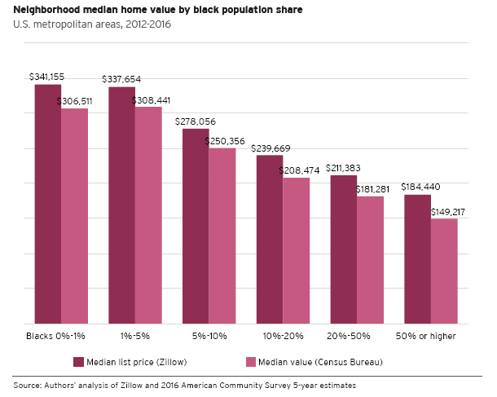
Devaluation of Assets in Black Neighborhoods
Perry et al. set out to explain the causes of large discrepancies in home values between treatment census tracts (>=50% Black residents) and control tracts (<1% Black residents) across 119 metropolitan areas. Using 2012-2016 data, treatment tracts were found to be valued at about half of control ones, or $150,000 less.*
* Andre Perry, Jonathan Rothwell, and David Harshbarger, The Brookings Institution, The Devaluation of Assets in Black Neighborhoods, https://www.brookings.edu/research/devaluation-of-assets-in-black-neighborhoods/, 2018

Slide 48
Devaluation of Assets in Black Neighborhoods (Cont.)
Perry used 23 housing structure characteristics and neighborhood amenities to analyze home value differences between the treatment and control tracts in a regression model.
# | Variable | Source
Structural Characteristics
1. | Median bedrooms | ACS 2012-2016
2. | Median year built | ACS 2012-2016
3. | Single-family detached share of owner-occupied units | ACS 2012-2016
4. | Single-family attached share of owner-occupied units | ACS 2012-2016
5. | Mobile homes share of owner-occupied units | ACS 2012-2016
6. | Homes with no vehicle availability | ACS 2012-2016
7. | Homes with gas or electric heating | ACS 2012-2016
8. | Homes with complete kitchen facilities | ACS 2012-2016
Neighborhood Amenities
9. | Mean commute of adult workers | ACS 2012-2016
10. | Percent of working adults who carpool to work | ACS 2012-2016
11. | Percent of working adults who use public transport | ACS 2012-2016
12. | Percent owner-occupied units | ACS 2012-2016
13. | Population (natural log) | ACS 2012-2016
14. | Percent of households with children under 18 | ACS 2012-2016
15. | Percent households headed by single mothers with children under 18 | ACS 2012-2016
16. | Median age of the population | ACS 2012-2016
17. | EPA Walkability Index | EPA
18. | Number of professional service businesses | County Business Patterns
19. | Number of libraries | County Business Patterns
20. | Number of museums and historical sites | County Business Patterns
21. | Number of food and drinking places | County Business Patterns
22. | Number of gas stations | County Business Patterns
23. | Proficiency rate of 4th-8th grade public school students | Perry’s Calculations
Source: Perry et al., as complied by the AEI Housing Center, www.AEI.org/housing.

Slide 49
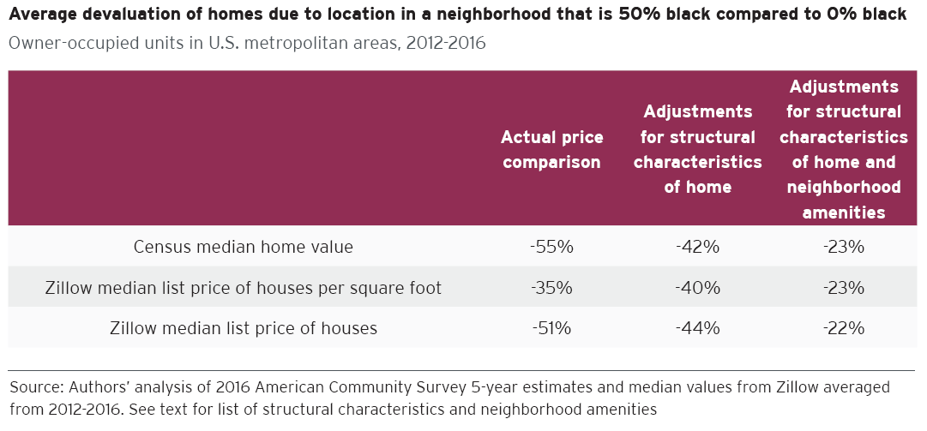
Devaluation of Assets in Black Neighborhoods (Cont.)
After controlling for the 23 structure characteristics and neighborhood amenities, the valuation gap falls to a still sizeable 23%. Thus, Perry et al. claim that homes in majority Black neighborhoods are undervalued by 23% as compared to an identical home in terms of structural characteristics and with identical neighborhood amenities in an almost entirely White neighborhood.*
This valuation gap amounts to $48,000 per home on average for owner-occupied homes across all majority black neighborhoods, totaling $156 billion in cumulative losses. Perry et al. attribute this gap to racial discrimination.
Source: Perry et al.
* Howell and Korver-Glenn arrive at a devaluation estimate of 32% after controlling for house and neighborhood characteristics for Black and Hispanic neighborhoods, which is similar to the results in Perry et al. As we point out in this working report for Perry et al., from a first glance we think that the Howell and Korver-Glenn study could be improved by creating more similar control and treatment groups. We will evaluate this paper in future research.

Slide 50
The AEI Housing Center Approach
In undertaking our analysis, we acknowledge that past racial discrimination shaped the neighborhoods we see today and that it is important to study what levels of racial discrimination remain. Analyzing the issues raised by Perry et al. is key to fashioning appropriate public and private responses. It is also important to evaluate whether what may appear to be race-based differences in home values, for example, are actually based on socioeconomic status. We therefore set out to improve on Perry’s methodology and to evaluate the progress, or lack thereof, the country has been making.
For our analysis of race-based differences in home values, we use the same 5-year 2016 ACS data as Perry et al. as our main data source. We also use the same definitions for Black neighborhoods and the same self-reported data on home values from the same ACS data as Perry et al.
We define income and home values as a percent of the metro median, which renders them more easily comparable across metros. The main area of difference to Perry et al. is that instead of using 23 control variables with the aim of rendering homes in neighborhoods of different racial make-up comparable, we focus on grouping neighborhoods with similar levels of income, thus standardizing buying power. Our approach generates similar comparison groups in terms of buying power, thus addressing Perry et al.’s concern that the use of income would merely reflect buying power.

Slide 51
Stage 1: Replicating Perry et al.’s Starting Point
When we define census tracts according to their share of Black residents in a similar fashion as Perry et al., we find roughly a 49% devaluation, similar to Perry et al.’s finding.
The chart below shows relative home value on the y-axis and the Black share of households on the x-axis for tracts in Perry’s 113 metros arrayed into bins based on the Black share. This comparison is done without controls for structural or neighborhood characteristics.
0 - <1% (Control): 133%
≥ 50% (Treatment): 68%
Devaluation: 49%
Note: We define relative income and home values as a percent of the metro median, which renders them more easily comparable across metros.
Source: Census and AEI Housing Center, www.AEI.org/housing.

Slide 52
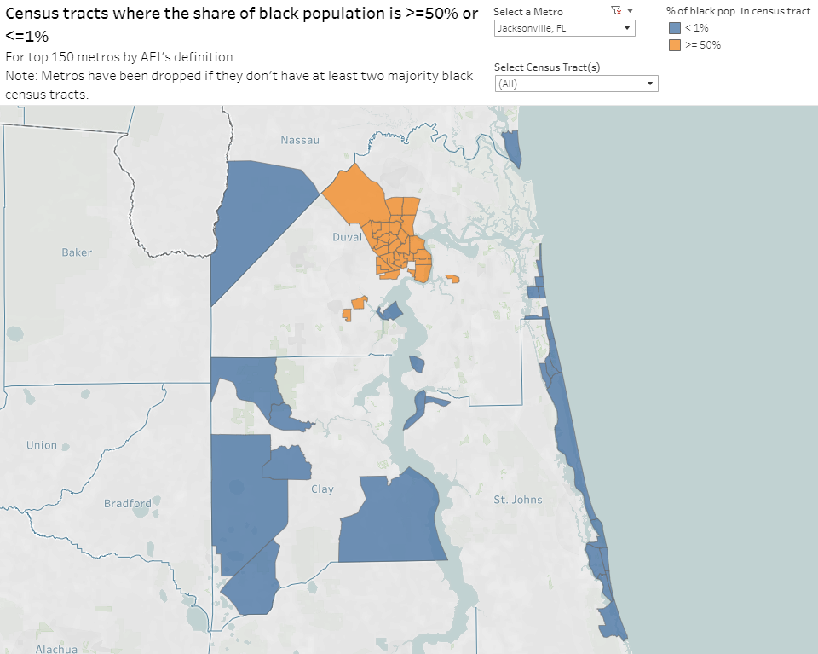
Main Area of Improvement:
Defining Better Control and Treatment Groups
When we compare the groups defined by Perry et al. (called neighborhoods), we find that they are not very similar in terms of other uncontrolled for characteristics besides racial make-up. These include, for example, population density, tract income as a % of AMI, and % of single mothers with children under 18. This suggests that the value gap, which Perry et al.’s attribute entirely to bias, may instead be due to omitted variables that would control for these dissimilarities.
Jacksonville, FL example
Summary Stats for Perry’s Control and Treatment Groups
 | % Blacks in Tracts
 | Control < 1% | Treatment >= 50%
Pop. Density (in people per sq. mile) | 5,810 | 9,834
Tract Income as % of AMI | 121.4 | 59.6
% Single Mothers with Children under 18 | 5.8 | 18.9
Waterfront & exurban
control tracts
vs.
mostly inner-city treatment tracts
Note: AMI stands for Area Median Income.
Source: Census and AEI Housing Center, www.AEI.org/housing.

Slide 53
Perry et al.’s View on Income As a Control
Income is not considered in Perry et al.’s model apart from level differences across metros. This excerpt from Perry et al. (p. 9) explains his justification for not including income in his model.
  We did not include household income or education directly in our model to estimate devaluation. Income and education reflect the buying power of individuals, and naturally, both tend to rise along with home values. Including them in the model would essentially test whether homes in black neighborhoods are over or under-valued relative to the purchasing power of residents; in other words, it would be estimating the affordability of housing. That is a different question than the one we ask here, which is whether homes are over or under-valued in black neighborhoods based on the qualities of the home and neighborhood in a given metropolitan housing market. People who live outside of the neighborhood are potential buyers and so should be considered part of the market.
Perry et al. state that including income has little impact on his results.
  Our devaluation estimate excluding income and education in this model is -22.7 percent, whereas it is -21.7 percent if we include them. We infer from this that home affordability patterns are similar for homeowners in majority black neighborhoods and those outside them, controlling for everything else we see about the home and neighborhood.
In summary, Perry et al. acknowledge differences in spending power across metros and controls for this at the metro level in his regression model. He argues that within a metro one does not need to control for differences in spending power and states that doing so would not materially result in different estimates.
Note: As Perry et al. do not explain the methodology used, we are unable to replicate their finding that controlling for income has little impact. We assume that in addition to their regular 23 variables, they included income and educational attainment as two additional explanatory variables and didn't bin for income as we do. We find that grouping neighborhoods with similar levels of income, thus standardizing buying power, the value gap shrinks by more than half.
Source: Perry et al. and AEI Housing Center, www.AEI.org/housing.

Slide 54
Our Improvement: More Similar Tracts through Income Ordering
While we are sympathetic with Perry et al.’s concern about including income, it must be acknowledged that income levels vary significantly across tracts. The greater the income differences are, the harder it will be to render tracts comparable due to omitted variables even with 23 control variables.
However, as demonstrated below, there is overlap between treatment and control groups, which we use to create more similar comparison groups.
In order to address the concern that the use of income would merely reflect buying power, we focus on the areas for which income for treatment and control tracts is similar, thus standardizing buying power.
In addition to the treatment and control tracts, Perry et al. also have the 4 intermediate groupings shown here. There is more income overlap between these groups and the treatment, which we hope to analyze in future work.
Note: We define relative income and home values as a percent of the metro median, which renders them more easily comparable across metros.
Source: Census and AEI Housing Center, www.AEI.org/housing.

Slide 55
Stage 2: Income Binning
When ordering on income to compare tracts with similar buying power, the gap between treatment and control tracts narrows significantly, from 51% to 19%.
Note that each of the lines ranges from the far left to the far right. However results on the edges of the chart need to be considered in relationship to the respective income distribution shown on the prior slide. For the control group, results below 70 are based on few tracts, while for the treatment group, results above 110 are based on few tracts.
Note: We define relative income and home values as a percent of the metro median, which renders them more easily comparable across metros. The chart shows a binned scatterplot, which groups the x-axis variable into separate bins, computes the mean of the x-axis and y-axis variables within each bin, then creates a plot of these data points. For clarity, we do not show the underlying dots of the binned scatter but only the quadratic fit lines. The binned scatter plot controls for level differences in values between metros through metro fixed effects. To compute the weighted devaluation, we first compute the percent devaluation for each relative income band and then weight the difference by the share of majority Black in this income range.
Source: Census and AEI Housing Center, www.AEI.org/housing.

Slide 56
Stage 3: Income Binning & Controlling for Single Mothers
After ordering the tracts on income, we control for the share of single mothers with children under 18 living in the home in each tract. This is one of Perry’s control variables, and is noted as being correlated with crime rates. We think it also captures socio-economic factors. When included, the gap between treatment and control tracts shrinks from Perry et al.’s 23% to a weighted difference of 6%. Without further research, we are unable to determine whether this is all or in part attributable to racial bias or omitted variables.
Based on our revised Perry approach, we conclude that homebuyers are sorting along socio-economic status (SES). The differences in SES explain about 75% of the gap Perry et al. attributed to race.
Note that each of the lines ranges from the far left to the far right. However results on the edges of the chart need to be considered in relationship to the respective income distribution shown on the prior slide. For the control group, results below 70 are based on few tracts, while for the treatment group, results above 110 are based on few tracts.
Note: We define relative income and home values as a percent of the metro median, which renders them more easily comparable across metros. The chart shows a binned scatterplot, which groups the x-axis variable into separate bins, computes the mean of the x-axis and y-axis variables within each bin, then creates a plot of these data points. For clarity, we do not show the underlying dots of the binned scatter but only the quadratic fit lines. The binned scatter plot controls for level differences in values between metros through metro fixed effects and the share of single mothers with children under 18. To compute the weighted devaluation, we first compute the percent devaluation for each relative income band and then weight the difference by the share of majority Black in this income range.
Source: Census and AEI Housing Center, www.AEI.org/housing.

Slide 57
Recap and Next Steps
Our approach improves on the methodology developed by Perry et al. in 2 important ways
  Creates more similar treatment and control groups through income binning.
  The 23 control variables are likely not enough to account for all differences in home characteristics and neighborhood amenities. We aim to account for these differences by controlling for SES using income binning and the tract share of single mothers with children under 18 living in the home.
This leads to two theories to account for substantial differences in home valuation:
  Perry et al.’s methodology attributes substantial differences in home valuations differences to racial bias.
  Our methodology attributes substantial differences in home valuations mainly to differences in socio-economic status (SES).
To test these theories, we utilize the following case studies:
1. Metros with very few Black people:
    If Perry et al. are right, these metros should not exhibit differences in valuations.
    If we are right, we should see valuation differences based on SES.
2. An analysis of Black home buyer preferences:
    If Perry et al. are right, Blacks have an economic reason to take advantage of lower prices in majority Black neighborhoods since these homes and neighborhoods are identical to higher priced White neighborhoods.
    If we are right, we should see Blacks buying homes in neighborhoods that are reflective of their SES, not race.
Source: Census and AEI Housing Center, www.AEI.org/housing.

Slide 58
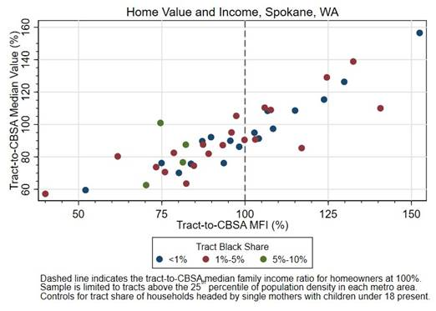
Case Study 1: Spokane, WA
Spokane, WA with a Black population share of 2% offers the near-ideal case with which to test the two competing theories.*
We find that census tracts with higher incomes exhibit higher home values while tracts with lower incomes exhibit lower home values. This seemingly runs counter to Perry et al.’s hypothesis that differences in value are due to race. Rather it appears that differences in value are due to SES.
If race were the only factor to explain differences in valuation, then we would expect to find values in a more or less straight horizontal line. At a minimum the results for the three types of tracts should organize themselves with the 5%- <10% tracts being consistently below the 1%- <5% tracts, which should be below the <1% tracts.
To be fair, the results here are before controlling for any home or neighborhood characteristics since we have been unable to replicate all of Perry et al. control variables.
Perhaps Perry et al. could show if their 23 control variables are indeed able to account for any differences in value in a metro like Spokane.
*Metros with very small Black population shares were excluded by Perry et. al as they
have no qualifying treatment tracts (>=50% Black residents).
Source: Census and AEI Housing Center, www.AEI.org/housing.

Slide 59
Case Study 2: Buyer Analysis
We evaluated around 1.2 million originated loans in 2019. The loan level data come from the Home Mortgage Disclosure Act (HMDA), which is a near census of loans.
We first assign each loan its neighborhood’s relative median value from the 5-year 2019 ACS data. We then compare the home values by race after controlling for income (a first proxy for SES but not a complete one as shown earlier), combined-loan-to-value (to address differences in resources for a down payment or parental help), loan type, age bracket of the borrower, and the tract’s share of single mothers with children under 18.
We find that home values in neighborhoods in which Blacks bought homes, were on average 2% lower than home values in neighborhoods in which Whites bought homes. This differential is less than one-tenth the 23% gap in Perry et al.
Based on these results, we conclude that Black and White borrowers of similar SES are buying homes in similarly valued neighborhoods.
These findings also runs counter to Perry et al.’s theory. If, as they claim, Black and White neighborhoods are identical in every aspect except for price, then why are Black buyers not taking advantage of lower priced homes in Black neighborhoods?
Source: HMDA and AEI Housing Center, www.AEI.org/housing.

Slide 60
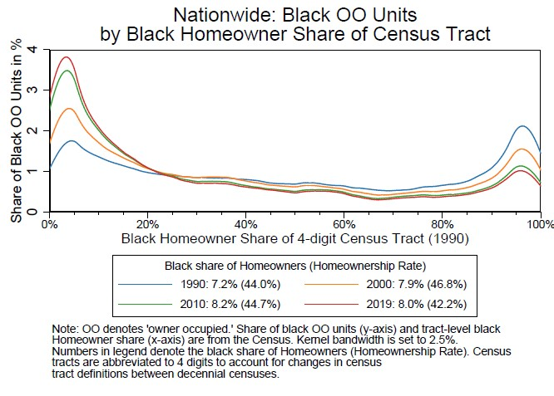
Progress in Racial Integration
While the Black homeownership rate in 2019 is below the same rate in 1990, the stock of Black homeowners has increasingly shifted to areas that were predominantly White in 1990. We find the same pattern for renters (not shown). Notwithstanding progress since 1990 when about 32% of housing units with a Black householder were in tracts with 80% or more Black residents, in 2019 about 17% of remain in such tracts.
Dissimilarity Score* (largest 100 metros):
1990: 70%
2000: 66%
2010: 61%
2019: 59%
*The dissimilarity index measures the share of Black residents (owners and renters) that would have to move to produce a distribution that matches that of the larger area.
Source: Census and AEI Housing Center, www.AEI.org/housing.

Slide 61
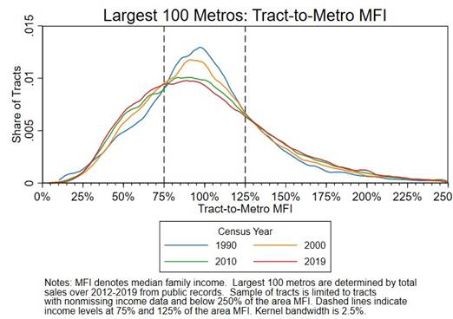
There Has Been an Increase in Stratification along Income and Socioeconomic Status
Here we measure the share of tracts within 75% and 125% of AMI. By this simple measure we can see that 54% of tracts in 1990 were within this range, compared to 44% in 2019.
Share of tracts
within 75% and 125% of AMI:
1990: 54%
2019: 44%
Note: MFI stands for Median Family Income and AMI stands for Area Median Income.
Source: Census, FFIEC, and AEI Housing Center, www.AEI.org/housing.

Slide 62
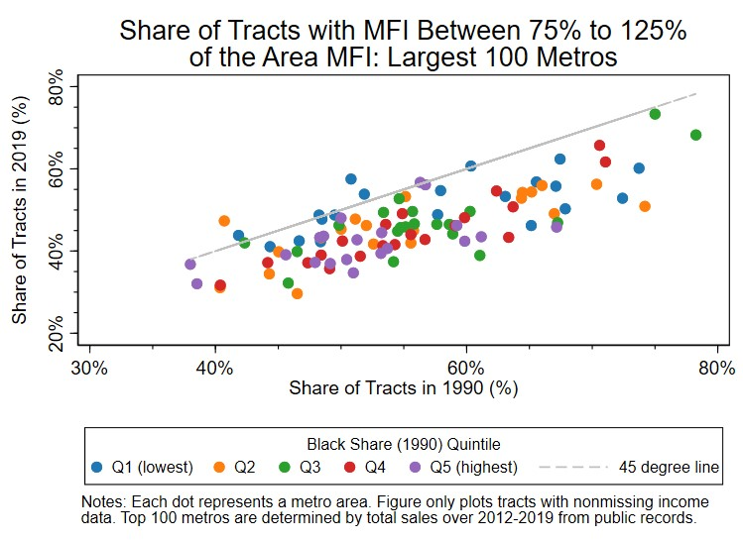
Segregation along Income/Socioeconomic Status
Since 1990, Income stratification has grown in virtually all of the largest 100 metros and is not correlated with minority share.
A dot above the 45 degree line implies reduced income stratification between 1990 and 2019, and vice versa.
Each dot represents a metro.
45 degree line
Note: MFI stands for Median Family Income.
Source: Census, FFIEC, and AEI Housing Center, www.AEI.org/housing.

Slide 63
Summary of Findings
Using our revised Perry et al. approach, which involves ordering the tracts into income bins and controlling for the share of single mothers with children under 18 living in the home in each tract, the gap between treatment and control tracts shrinks from Perry et al.’s 23% to a weighted difference of 6%.
Based on the results from our revised Perry et al. approach, we conclude that homebuyers are sorting along socio-economic status (SES). The differences in SES explain about 75% of the gap Perry et al. attributed to race.
We think that differences in SES, not race, explain differences in valuations.
We find that the stock of Black homeowners has increasingly shifted to areas that were predominantly White in 1990. While the country as a whole has been making progress in racial integration, much work remains to be done.
We identify a serious emerging problem: growing income stratification, which does not appear to be race-related but which poses serious policy challenges.
Source: AEI Housing Center, www.AEI.org/housing.

Slide 64
Housing Related Policy Solutions Based on Our Findings
Diagnosing the causes of the home value gap, along with a recognition of decreasing racial and ethnic segregation and increasing Socio-Economic Status (SES) stratification, helps in the consideration of appropriate policy solutions that will increase financial security and shrink the SES gap. Several such policy solutions are:
  Building generational wealth through sustainable homeownership for low SES households by reducing leverage for aspiring low-income home buyers,
    Low-Income First Time Homebuyer (LIFT Home) assistance that is used to buy down the interest rate on a 20-year term loan, would subsidize wealth building, rather than debt.
  Increasing supply and reducing income stratification through Light Touch Density,
    Making 2, 3, and 4 unit housing legal in 1-unit neighborhoods.
    Allow extra rooms in homes to be rented out.
    Promote walkable neighborhoods with a mix of residential and commercial properties.
Source: AEI Housing Center, www.AEI.org/housing.

Slide 65
Other Policy Solutions Based on Our Findings*
  Encouraging 2 parents in households with children
    Child tax credits should focus on low income households and should reward having two parents in the household.
  Enact occupational licensing reforms and allow small businesses to be run out of their home
    This would give families another path to upward mobility.
  More economical childcare by rolling back burdensome government regulations
    This would allow parents to decide whom they trust with their children.
  Real school choice for access to quality elementary and secondary education
    Expand charter schools and voucher programs.
    Parents would not have to buy a more expensive home to get access to a better education.
  Improving access to technical and apprenticeship training
    Public-private partnerships to promote training and skill development.
    Provide flexible vouchers to low-income students, thereby letting them spend the money in a way to quickly and efficiently gain job skills.
Many thanks to our AEI colleagues Naomi Schaefer Riley and Angela Rachidi for many of these ideas. Please see their thoughtful analysis: https://reason.com/2021/02/24/fix-family-poverty-with-free-markets-for-once/

