Slide 1
Duty to Serve Underserved Market Plans 2025-2027
Affordable Housing Preservation Market
2024 Duty to Serve
Public Listening Sessions
July 17, 2024

Slide 2
Affordable Housing Preservation
2025-2027 Underserved Market Plan
By the NUMBERS
14 Total objectives
5 Single-Family objectives
9 Multifamily objectives
2022-23 Accomplishments
Purchased 4 Section 515 loans for the first time in 2023, supporting 248 units in affordable properties located in rural areas
Launched the Energy Savings Program Finder and a test-and-learn to connect very low-income homeowners with Weatherization Assistance Programs
Continued energy modeling work to estimate borrowers' energy burden
What’s New in 2025-27?
Simplify shared equity loan delivery through loan performance and appraisal analyses
Support the rehabilitation of single-family homes
Support technical assistance programs that help prepare multifamily properties to adapt to weather-related risks or prepare for natural disasters
Purchase multifamily loans secured by properties with Sponsor-Initiated Affordability restrictions
Work Continuing in 2025-27
Purchase loans secured by properties under Section 8, LIHTC, or State / Local affordable housing programs
Support technical assistance programs that facilitate preservation of Section 515 properties
Support standardization in the shared equity market through program certification
Reduce homeowner utility costs through tools, programs, and products

Slide 3
Duty to Serve Underserved Market Plans 2025-2027
Affordable Housing Preservation Market
2024 Duty to Serve
Public Listening Sessions
July 17, 2024

Slide 6
Duty to Serve Underserved Market Plans 2025-2027
Affordable Housing Preservation Market
2024 Duty to Serve
Public Listening Sessions
July 17, 2024

Slide 7
2024 Duty to Serve Public Listening Sessions
BREAK

Slide 8
Duty to Serve Underserved Market Plans 2025-2027
Affordable Housing Preservation Market
2024 Duty to Serve
Public Listening Sessions
July 17, 2024

Slide 9
Public Listening Conference: FHFA Duty to Serve 2025-2027
Presented by: Demetrius Roberts, MHA, PMP
17 July 2024
Location: Upper Marlboro, MD, 20774

Slide 10
# | FHFA Question | Response | Discussion | Impact | Recommendations
1 | Do the proposed 2025-2027 activities and objectives address the most relevant obstacles to liquidity in the applicable underserved market | No | Fannie Mae/Freddie Mac: AI/NA as the targeted population. This is the smallest of the race categories. Lacks inclusivity | Fannie Mae: The identification of AI 1.2% (ALL RURAL Racial Categories) Current strategy does not provision expansion of targets of opportunity aligned to the Rule 12 CFR 1293 released 16 May 2024 | Fannie Mae/Freddie Mac: Expand on other race groups to improve equity and access akin to Alaskan and Native American groups.
2 | Are the proposed objectives likely to increase liquidity in the applicable underserved market | Partially | Fannie Mae: A broad perspective of additional race categories are not addressed with no explanation of expansion of race groups in 2025-2027 | Fannie Mae: Selection of one racial category disadvantages 97% of the population within targeted FHFA rural market of opportunity | FHFA: If revision is requested state the expectation that entities are to expand beyond previous submitted DTS plans
Notes:
. Do the proposed 2025-2027 activities and objectives address the most relevant obstacles to liquidity in the applicable underserved market? 2. Are the proposed objectives likely to increase liquidity in the applicable underserved market? 3. Is there other information that the Enterprises should supply in their expanded Strategic Priority Statements in their Plans for the rural housing market to provide an adequate basis for their strategies to address access to liquidity and other housing finance needs in all rural areas? 4. Are there other activities and objectives that the Enterprises should consider adding to their Plans for the rural housing market to address access to liquidity and other housing finance needs in all rural areas? 5. Are there other activities and objectives the Enterprises should consider adding to their Plans for the manufactured housing and affordable housing preservation markets to address access to liquidity and other housing finance needs in those markets? 6. Should the Enterprises adjust the methodology used to set loan purchase baselines for 2025-2027, given current market conditions including elevated interest rates? 7. Are there other market conditions that FHFA should consider when assessing the proposed activities and objectives? 8. Are there any safety and soundness con

Slide 11
# | FHFA Question | Response | Concern | Reasoning | Recommendations
3 | Is there other information that the Enterprises should supply in their expanded Strategic Priority Statements in their Plans for the rural housing market to provide an adequate basis for their strategies to address access to liquidity and other housing finance needs in all rural areas? | Yes | Fannie Mae: Black and Brown Colored People are not represented in this plan nor disadvantaged White populations. | Fannie Mae: Lack of diversity outside of AI/NA Current strategy benefits 1,1M people of the 82M in Rural Areas | Fannie Mae/Freddie Mac: Include targeted action statements to create equity and duty to serve action for all race demographics (all or none principle) Constraint Acknowledgement: FHFA guidance states utilize previous methodology as a basis to support recommendations but calls for expansion. Therefore, 2025-2026 submission should contain additional racial diversity for equity for duty to serve obligation
Notes:
. Do the proposed 2025-2027 activities and objectives address the most relevant obstacles to liquidity in the applicable underserved market? 2. Are the proposed objectives likely to increase liquidity in the applicable underserved market? 3. Is there other information that the Enterprises should supply in their expanded Strategic Priority Statements in their Plans for the rural housing market to provide an adequate basis for their strategies to address access to liquidity and other housing finance needs in all rural areas? 4. Are there other activities and objectives that the Enterprises should consider adding to their Plans for the rural housing market to address access to liquidity and other housing finance needs in all rural areas? 5. Are there other activities and objectives the Enterprises should consider adding to their Plans for the manufactured housing and affordable housing preservation markets to address access to liquidity and other housing finance needs in those markets? 6. Should the Enterprises adjust the methodology used to set loan purchase baselines for 2025-2027, given current market conditions including elevated interest rates? 7. Are there other market conditions that FHFA should consider when assessing the proposed activities and objectives? 8. Are there any safety and soundness con

Slide 12
# | FHFA Question | Response | Concern | Reasoning | Recommendations
4 | Are there other activities and objectives that the Enterprises should consider adding to their Plans for the rural housing market to address access to liquidity and other housing finance needs in all rural areas | Yes | Fannie Mae: Broad allocation of purchases to multifamily properties (2023-2025) (Lack of context) 23. 2025-2027 2. Fannie Mae/Freddie Mac: Borrowers/Renters inclusion as a consulted and included stakeholder: | Fannie Mae/Freddie Mac: Without context of the geographic regions FHFA/public will not be able to understand how their specific geographic regions are being targeted for FHFA. (Lack of information) Exclusion of the customers as stakeholders to serve on the development plans for which Freddie Mac has supplied is exclusionary Fannie Mae/Freddie Mac: Community Action Groups to proactively identify safety and soundness risks through active community engagement (task forces, working groups, volunteers, inbox for complaints such as OIG) | Fannie Mae: Put a map of these regions to target OR COA 1, Specify Research as a deliverable for FY-25 COA 2: defer purchase until current state of needs are known to Freddie Mac. 2. Fannie Mae/Freddie Mac: Risk Mitigation by including Home Loan Borrowers. Current model precludes home loan borrowers as a stakeholder with equity to improve duty to serve, safety and soundness concerns, and equity gaps to foster proactive detection of issues prior to problem is identified later through major market / losses. The selected groups have equity to make decisions to the current DTS requirements, adding in a consumer stakeholder group with equity to vote and advise can balance the power of inequities FHFA should not be the only forum for addressing DTS. Freddie Mac/Fannie Mae should engage the public as an additional step for DTS
Notes:
. Do the proposed 2025-2027 activities and objectives address the most relevant obstacles to liquidity in the applicable underserved market? 2. Are the proposed objectives likely to increase liquidity in the applicable underserved market? 3. Is there other information that the Enterprises should supply in their expanded Strategic Priority Statements in their Plans for the rural housing market to provide an adequate basis for their strategies to address access to liquidity and other housing finance needs in all rural areas? 4. Are there other activities and objectives that the Enterprises should consider adding to their Plans for the rural housing market to address access to liquidity and other housing finance needs in all rural areas? 5. Are there other activities and objectives the Enterprises should consider adding to their Plans for the manufactured housing and affordable housing preservation markets to address access to liquidity and other housing finance needs in those markets? 6. Should the Enterprises adjust the methodology used to set loan purchase baselines for 2025-2027, given current market conditions including elevated interest rates? 7. Are there other market conditions that FHFA should consider when assessing the proposed activities and objectives? 8. Are there any safety and soundness con

Slide 13
# | FHFA Question | Response | Concern | Reasoning | Recommendations
5 | Is there other information that the Enterprises should supply in their expanded Strategic Priority Statements in their Plans for the rural housing market to provide an adequate basis for their strategies to address access to liquidity and other housing finance needs in all rural are | Yes | Fannie Mae: Expanded race targeted groups. | (Fannie Mae) Current strategy benefits 1.1M people of the 82M in Rural Areas Selection of the smallest population for achievement of FHFA targeted incentives. Freddie acknowledges lack of knowledge in other underserved populations, but specified AI/AP. | Fannie Mae: More needs to be done to address diversity across all race groups
Notes:
. Do the proposed 2025-2027 activities and objectives address the most relevant obstacles to liquidity in the applicable underserved market? 2. Are the proposed objectives likely to increase liquidity in the applicable underserved market? 3. Is there other information that the Enterprises should supply in their expanded Strategic Priority Statements in their Plans for the rural housing market to provide an adequate basis for their strategies to address access to liquidity and other housing finance needs in all rural areas? 4. Are there other activities and objectives that the Enterprises should consider adding to their Plans for the rural housing market to address access to liquidity and other housing finance needs in all rural areas? 5. Are there other activities and objectives the Enterprises should consider adding to their Plans for the manufactured housing and affordable housing preservation markets to address access to liquidity and other housing finance needs in those markets? 6. Should the Enterprises adjust the methodology used to set loan purchase baselines for 2025-2027, given current market conditions including elevated interest rates? 7. Are there other market conditions that FHFA should consider when assessing the proposed activities and objectives? 8. Are there any safety and soundness con

Slide 14
# | FHFA Question | Response | Concern | Reasoning | Recommendations
6 | Are there other activities and objectives that the Enterprises should consider adding to their Plans for the rural housing market to address access to liquidity and other housing finance needs in all rural areas | Yes | Fannie Mae: Research is broadly used as a means for understanding the needs of Rural Populations. | Fannie Mae: Lack of specificity of how research studies will be conducted | Fannie Mae: Expound research methodology for rigor, reasoning, repeatability, and alignment to the FHFA goals for housing equity as cited in FHFA Rule 12 CFR 1293 released May 2024. Incorporate FHFA Rule 12 CFR 1293 released May 2024 named racial groups as underrepresented and disparate treatment/quality of housing as a targeted opportunity for expanding DTS/soundness outside of current demographic Triangulation through focus groups, community engagements, and stakeholder analysis beyond the banks, developers, and builders to support future objective development
Notes:
. Do the proposed 2025-2027 activities and objectives address the most relevant obstacles to liquidity in the applicable underserved market? 2. Are the proposed objectives likely to increase liquidity in the applicable underserved market? 3. Is there other information that the Enterprises should supply in their expanded Strategic Priority Statements in their Plans for the rural housing market to provide an adequate basis for their strategies to address access to liquidity and other housing finance needs in all rural areas? 4. Are there other activities and objectives that the Enterprises should consider adding to their Plans for the rural housing market to address access to liquidity and other housing finance needs in all rural areas? 5. Are there other activities and objectives the Enterprises should consider adding to their Plans for the manufactured housing and affordable housing preservation markets to address access to liquidity and other housing finance needs in those markets? 6. Should the Enterprises adjust the methodology used to set loan purchase baselines for 2025-2027, given current market conditions including elevated interest rates? 7. Are there other market conditions that FHFA should consider when assessing the proposed activities and objectives? 8. Are there any safety and soundness con

Slide 15
# | Question | Response | Concern | Reasoning | Recommendations
7 | Are there other market conditions that FHFA should consider when assessing the proposed activities and objectives? 8. Are there any safety and soundness concerns related to the proposed activities and objectives? 9. What additional information might be helpful in evaluating the proposed activities and objectives? | Yes | Fannie Mae: Gap in equity of other racial groups targeted in Rural effort outside of American Indian/Alaskan Population for 2025-2027 plan. | Fannie Mae: Realistic to already known markets. Fannie Mae has adapted its previous strategy, and integrated language of Fannie Mae to comply with evaluation | Consider requested both entities expanding upon the 16 May 2024 FHFA rule released by FHFA for race groups underrepresented/underserved. Or Create metrics to align Freddie Mac/Fannie Mae to additional targets in in FYs 26/27.
8 | Are there any safety and soundness concerns related to the proposed activities and objectives | Yes | CDFI incorporation | FHFA Lack of extensive oversight and the potential for builders/developers exploit gaps within CDFI to disadvantage homeowners | FHFA develop a phase in plan for oversight to avoid fraud by developers and builders to manipulate loose standards of CDFI to get around oversight Fannie Mae is subjected to
Notes:
. Do the proposed 2025-2027 activities and objectives address the most relevant obstacles to liquidity in the applicable underserved market? 2. Are the proposed objectives likely to increase liquidity in the applicable underserved market? 3. Is there other information that the Enterprises should supply in their expanded Strategic Priority Statements in their Plans for the rural housing market to provide an adequate basis for their strategies to address access to liquidity and other housing finance needs in all rural areas? 4. Are there other activities and objectives that the Enterprises should consider adding to their Plans for the rural housing market to address access to liquidity and other housing finance needs in all rural areas? 5. Are there other activities and objectives the Enterprises should consider adding to their Plans for the manufactured housing and affordable housing preservation markets to address access to liquidity and other housing finance needs in those markets? 6. Should the Enterprises adjust the methodology used to set loan purchase baselines for 2025-2027, given current market conditions including elevated interest rates? 7. Are there other market conditions that FHFA should consider when assessing the proposed activities and objectives? 8. Are there any safety and soundness con

Slide 16
# | Question | Response | Concern | Reasoning | Recommendations
9 | What additional information might be helpful in evaluating the proposed activities and objectives? | Yes | Black and Brown Colored People are not represented in this call out Data Sets Uncategorized Idea: | 1. Lack of diversity outside of AI/NA 2. Data sets for targeted populations should match FHFA data sets for congruency, repeatability, rigor, transparency, and avoid fraud/waste/abuse 3 a. (Developers, Community Housing Partners are stakeholders, and secondary relationship excludes the consumer from the stakeholder group). 3b. Fraud Prevention | 1. Inclusion of explicitly diversity statements or races for targeting outside of current race called out AI/NA How are both entities going to improve access to minority populations to access capital to purchase multifamily properties. 2. FHFA is the evaluator, THEREFORE, so common data sets familiar to FHFA should drive study. If not, the entity should explicitly state incongruence with FHFA dataset and the articulated disadvantage to their entity for exclusion. 3a. The inclusion of homeowners/residents of targeted rural areas as stakeholders for collaboration, and are representative of all race / impacted underrepresented/underserved populations 3 b. Statement to proactively audit/advocate safety/soundness concerns coming to their attention
Notes:
. Do the proposed 2025-2027 activities and objectives address the most relevant obstacles to liquidity in the applicable underserved market? 2. Are the proposed objectives likely to increase liquidity in the applicable underserved market? 3. Is there other information that the Enterprises should supply in their expanded Strategic Priority Statements in their Plans for the rural housing market to provide an adequate basis for their strategies to address access to liquidity and other housing finance needs in all rural areas? 4. Are there other activities and objectives that the Enterprises should consider adding to their Plans for the rural housing market to address access to liquidity and other housing finance needs in all rural areas? 5. Are there other activities and objectives the Enterprises should consider adding to their Plans for the manufactured housing and affordable housing preservation markets to address access to liquidity and other housing finance needs in those markets? 6. Should the Enterprises adjust the methodology used to set loan purchase baselines for 2025-2027, given current market conditions including elevated interest rates? 7. Are there other market conditions that FHFA should consider when assessing the proposed activities and objectives? 8. Are there any safety and soundness con

Slide 17
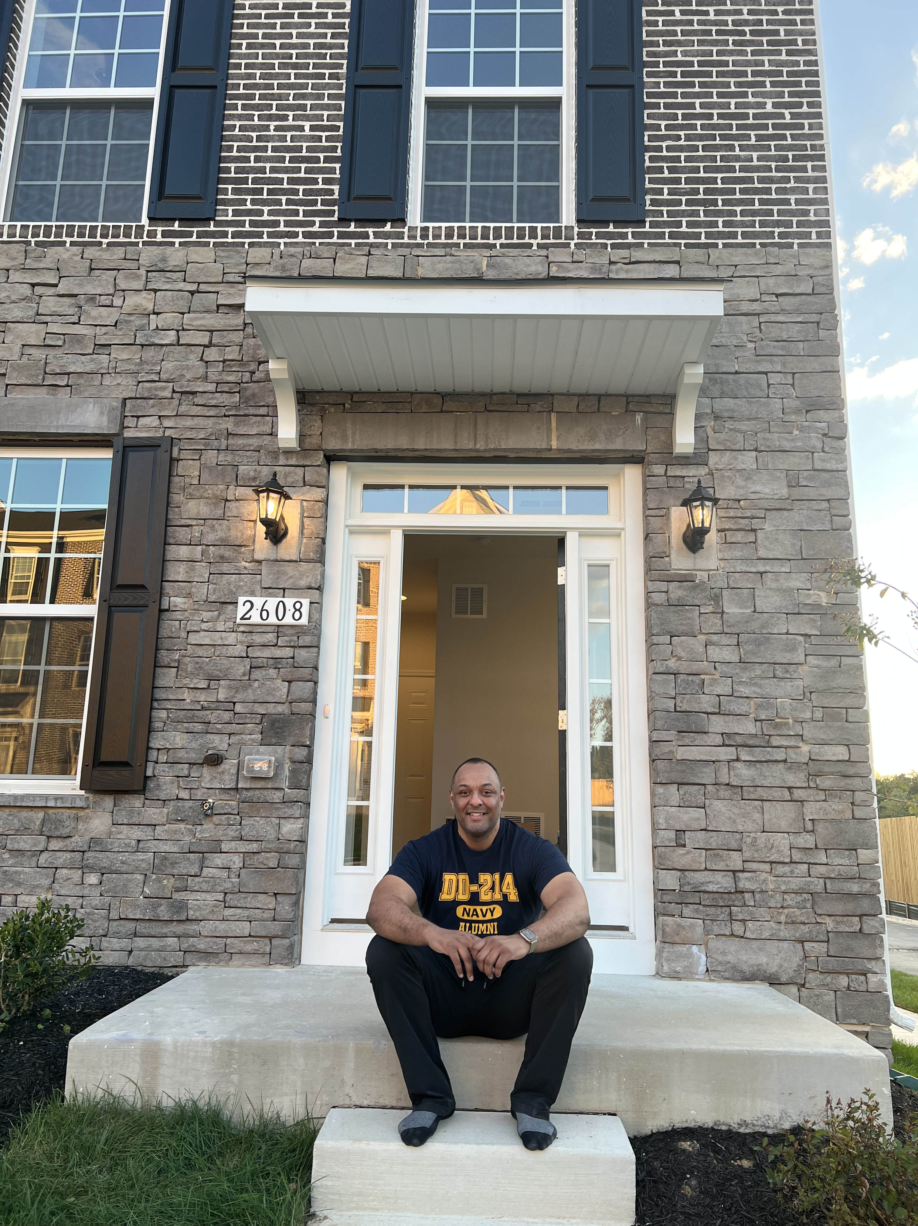
Positionality
My why:
Disadvantaged by unfair equitable practices in mortgage origination by multiple cited parties in plan (Loan Officers, Builders, and Developers)
New Entrepreneur – Service Disabled Veteran Owned Small Business ISO Change Management/Project Management
Honorably Discharged Combat Navy Veteran 2000-2020

Slide 18
Positionally cont’d
University of Southern California EdD Student – Organizational Change and Leadership (2021-Expected Graduation Summer 2025)
Dissertation:
Retrospective Lens: Lived Experiences of Undergraduate Alumni with a history of Foster Care
Notes:
Problem Statement: Only 3% of foster youth persist through undergraduate programs, with many facing homelessness and incarceration within two years of leaving care. Despite passage of the the 1985 Independent Living Act, empirical studies focusing on educational barriers have not significantly improved these outcomes. By using appreciative inquiry, I aim to highlight the resilience of these individuals, inform policy, address system gaps, and reduce barriers and associated costs.
DEMETRIU@USC.EDU

Slide 19
Contact Information
LinkedIn Link: http://linkedin.com/in/demetrius-roberts2020
Email: info@drconsultancy.org (business)

Slide 20
Duty to Serve Underserved Market Plans 2025-2027
Affordable Housing Preservation Market
2024 Duty to Serve
Public Listening Sessions
July 17, 2024

Slide 21
2024 Duty to Serve Public Listening Sessions
Thank you for joining us.
For more information, visit:
fhfa.gov/programs/duty-to-serve

