Slide 1
Duty to Serve Underserved Market Plans 2025-2027
Manufactured Housing Market
2024 Duty to Serve
Public Listening Sessions
July 16, 2024

Slide 2
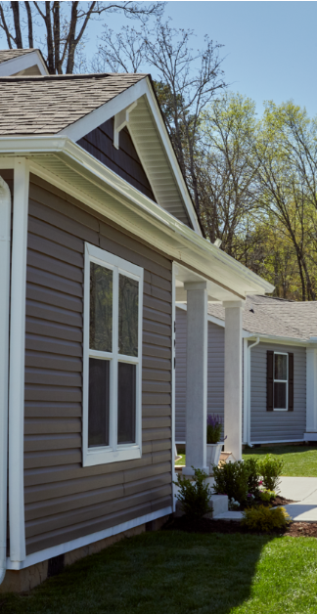
Manufactured Housing
2025-2027 Underserved Market Plan
By the NUMBERS
9 Total objectives
6 Single-Family objectives
3 Multifamily objectives
2022-23 Accomplishments
Purchased loans of manufactured housing communities (MHC) with Tenant Site Lease Protections totaling $4.8 billion and 108,968 pads
Expanded financing for single-wide MH
Expanded financing options for manufactured homes under secure tenancy arrangements, including homes in resident-owned communities (ROCs) and homes on tribal trust land.
What’s New in 2025-27?
Expand loan and digital product criteria to support additional MH mortgage lending
Broaden use of manufactured housing through new, federally enabled market expansion opportunities.
To improve Single Family financing, develop a community of practice focused on secure tenancy in MHCs.
Increase purchase of MHC loans with affordability created by rent restrictions
Work Continuing in 2025-27
Acquire purchase money mortgage loans secured by manufactured housing real property (MHRP)
Support Single Family financing for MH in ROCs in markets that recognize homes on leased land as real property
Increase loan purchases activity for MHCs owned by government entities, nonprofits, or residents
Purchase MHC loans financing properties which have incorporated the tenant site lease protections.

Slide 3
Duty to Serve Underserved Market Plans 2025-2027
Manufactured Housing Market
2024 Duty to Serve
Public Listening Sessions
July 16, 2024

Slide 6
2024 Duty to Serve Public Listening Sessions
BREAK

Slide 7
2024 Duty to Serve Public Listening Sessions
JOIN US FOR AN ADDITIONAL LISTENING SESSION THIS WEEK:
Duty to Serve Public Listening Session Day 3 July 17, 2024 | Affordable Housing Preservation

Slide 8
2024 Duty to Serve Public Listening Sessions
Thank you for joining us.
For more information, visit:
fhfa.gov/programs/duty-to-serve

