Slide 1
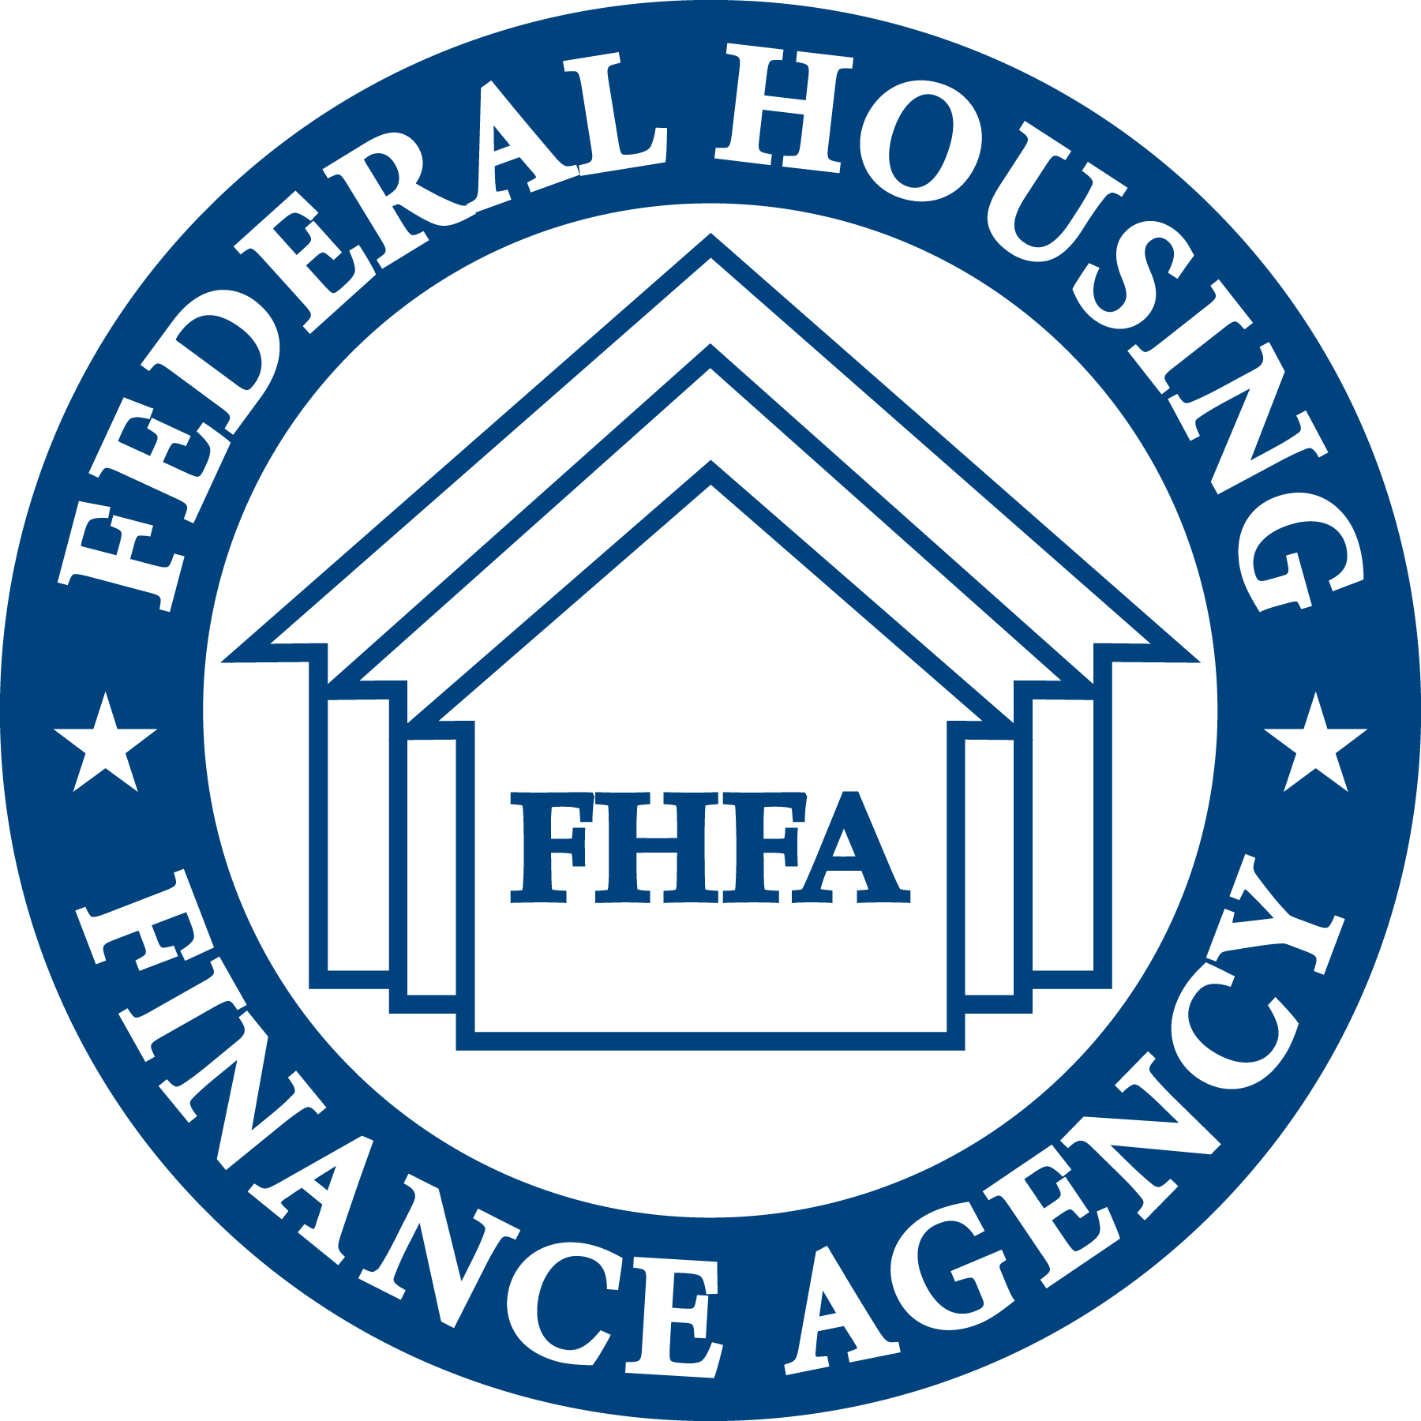
Duty to Serve Underserved Market Plans 2025-2027
Rural Housing Market
2024 Duty to Serve
Public Listening Sessions
July 15, 2024

Slide 2
Rural Housing
2025-2027 Underserved Market Plan
By the NUMBERS
12 Total objectives
6 Single-Family objectives
6 Multifamily objectives
2022-23 Accomplishments
Supported training to 22 developers focused on high needs rural populations resulting in 11 applications for housing development funding in 2022
Published “A Methodological Approach to Estimate Residential Heirs’ Property in the United States” and socialized findings broadly to inform future efforts.
What’s New in 2025-27?
Acquire multifamily loans in broader rural market
Conduct research on barriers facing rural homeowners and renters
Enable rural community development financial institutions to access secondary markets
Increase single-family lending in colonia census tracts
Increase single-family loans made to tribal members living in Indian areas
Work Continuing in 2025-27
Acquire single-family and multifamily loans in high-needs rural regions
Increase mortgage opportunities for rural residents of heirs’ property
Support housing for agricultural workers and Native American communities

Slide 3
Duty to Serve Underserved Market Plans 2025-2027
Rural Housing Market
2024 Duty to Serve
Public Listening Sessions
July 15, 2024

Slide 6
Duty to Serve Underserved Market Plans 2025-2027
Rural Housing Market
2024 Duty to Serve
Public Listening Sessions
July 15, 2024

Slide 8
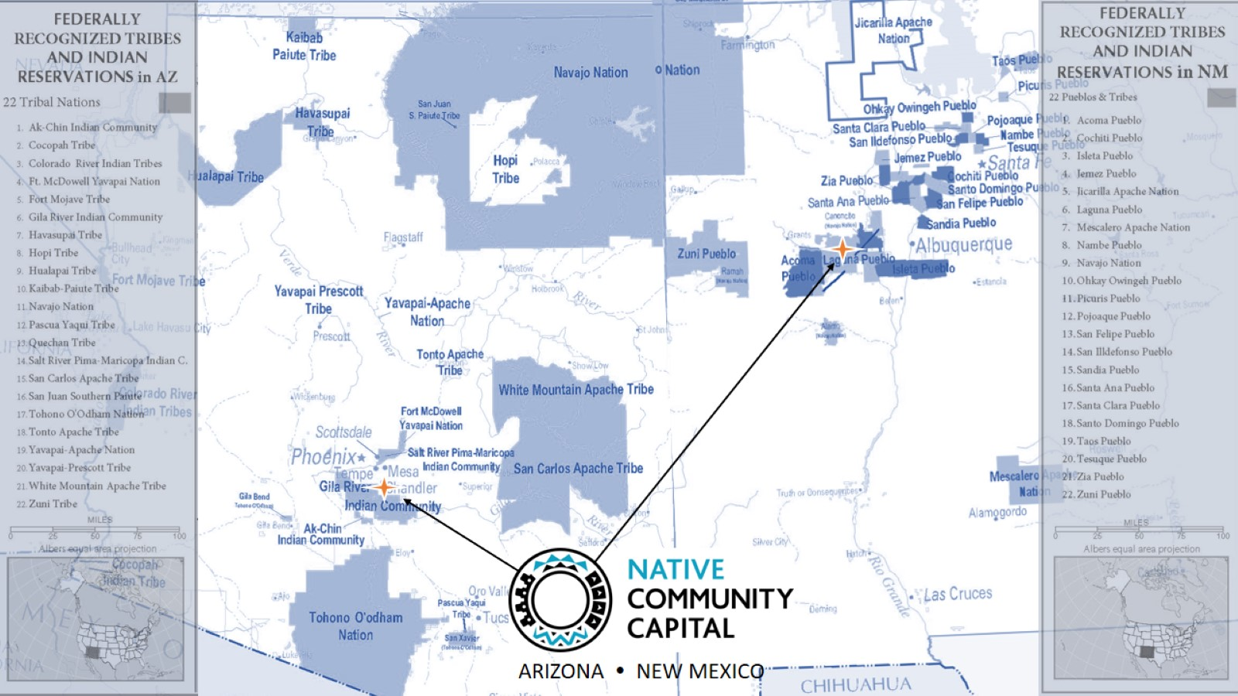

Slide 11
Small Business Lending 2018-2021

Slide 15
Duty to Serve Underserved Market Plans 2025-2027
Rural Housing Market
2024 Duty to Serve
Public Listening Sessions
July 15, 2024

Slide 16
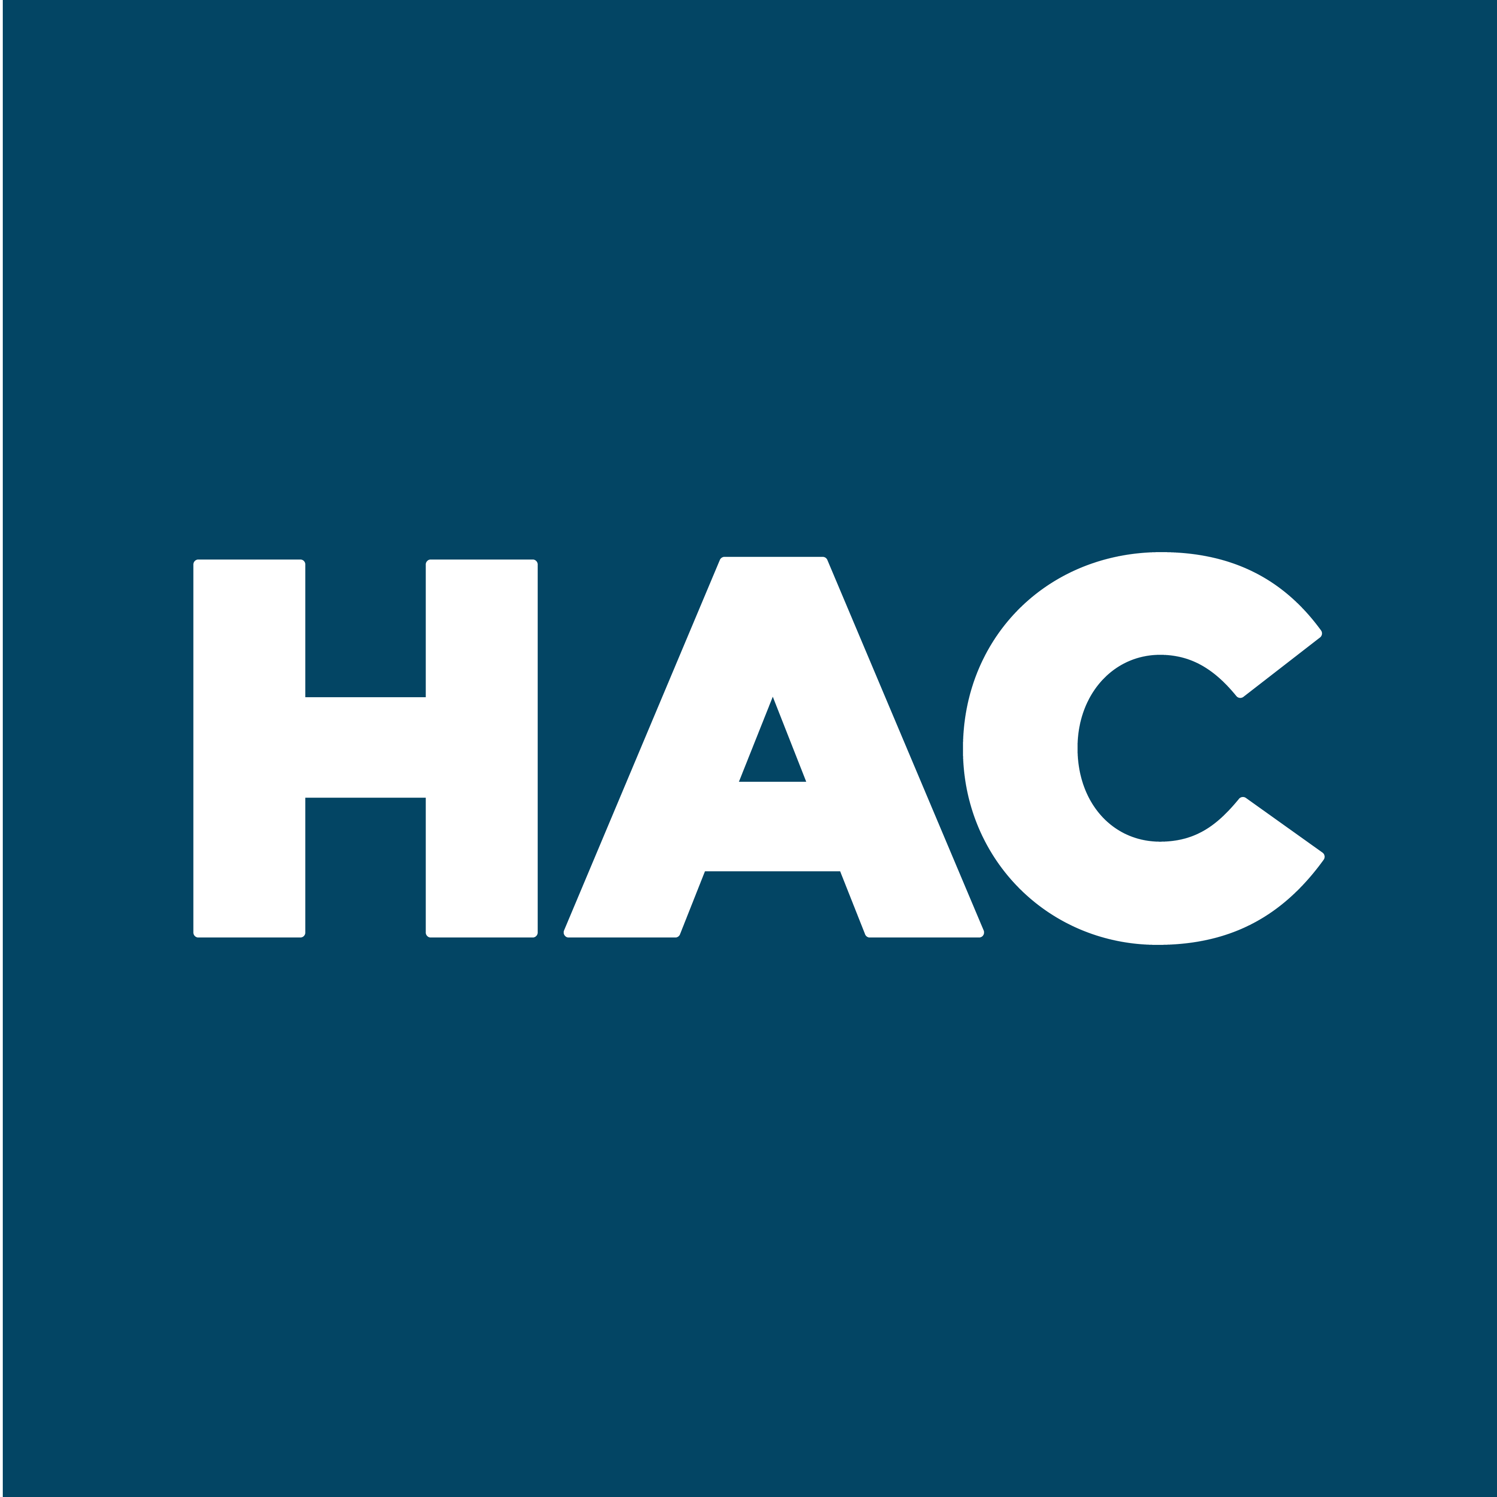
FHFA Duty to Serve Rural Listening Session
Samantha Booth
Government Relations Manager
May 15, 2024

Slide 17
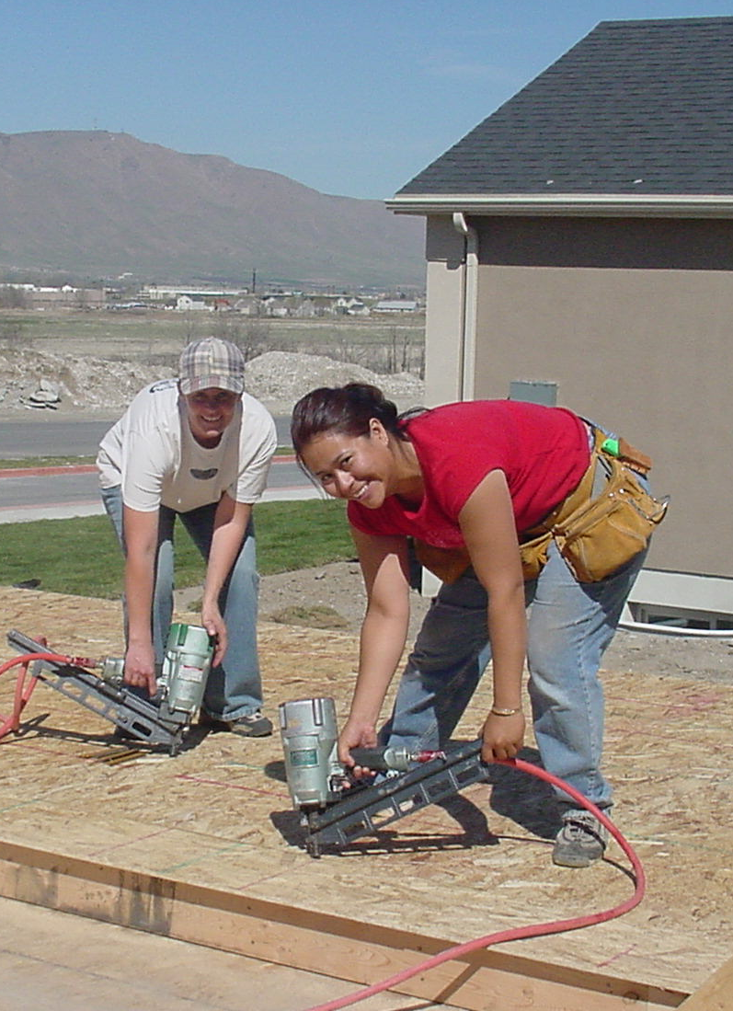
The Housing Assistance Council (HAC) is a national nonprofit and certified Community Development Financial Institution (CDFI) dedicated to helping local rural organizations build and preserve affordable homes.
Training & Technical Assistance
Developing the capacity of local nonprofit organizations to help their own communities
HAC Loan Fund
Providing capital in the hardest to serve places
Research & Information
Leading resource on rural housing data and issues
Policy & Advocacy
Informing sound strategies and policies that help improve housing and communities across rural America

Slide 18
2025-2027 Rural DTS Plans

Slide 19
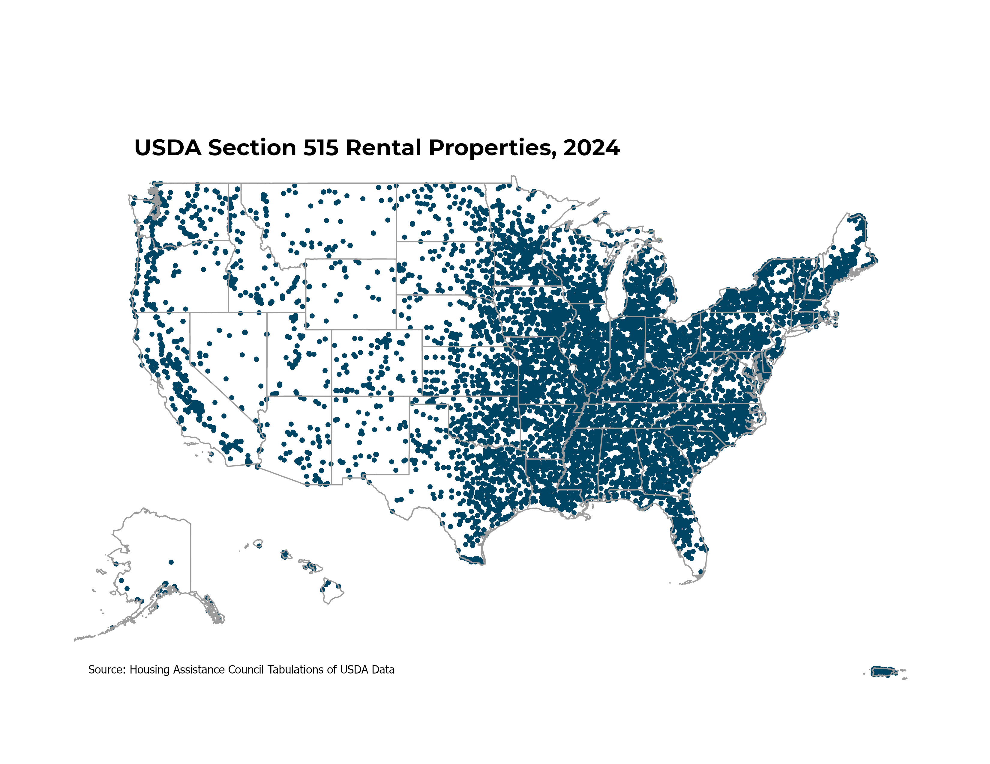
USDA Section 515 Preservation

Slide 20
USDA Section 515 Preservation (cont.)
Fannie Mae:
Partner with nonprofits to provide 515 preservation technical assistance to 30 orgs per year
Finance the purchase of 85 units of 515 housing per year
Freddie Mac:
No specific Section 515 purchase goals

Slide 21
Equity Investments in CDFIs
The FHFA could make a huge impact by permitting targeted equity investments in CDFIs.
Fannie Mae included CDFI equity investments in their last plan cycle but didn't this time.
Both GSEs should include targeted equity investments to push FHFA on this issue.

Slide 22
Housing in Native Communities
Fannie Mae includes goals to:
1) partner with nonprofits to provide TA to 20 orgs working in Native or farmworker communities each year, and
2) purchase 10 single family NACLI or 184 loans in 2025, 15 loans in 2026, and 20 loans in 2027.
Freddie Mac’s proposed plan includes:
1) purchase 20 single family HeritageOne or 184 loans in 2025, 22 loans in 2026, and 25 loans in 2027, and
2) assess the effectiveness of the HeritageOne product each year and make product enhancements.

Slide 23
Heirs’ Property
Freddie Mac includes a goal around homeowner education for heirs’ property.
Fannie Mae includes a goal around creating a pilot or loan product for rural residents of heirs' property.

Slide 24
Housing in Colonias
Fannie Mae includes an “outreach”-focused goal related to colonias.
Freddie Mac doesn't include anything specific for colonias.

Slide 25
Low Baselines and Goals That Do Not Scale Year-Over-Year
Both Enterprises tend to set baselines as low as possible by removing from consideration years they deem atypical, and also offer goals that don't scale up year-over-year.

Slide 26
Broader Rural Goals Not Attached to HNRRs or HNRPs
Fannie includes a new activity in this Plan cycle to "support the rural housing market as most broadly defined by the regulation.”

Slide 27
2024 Duty to Serve Public Listening Sessions
BREAK

Slide 28
2024 Duty to Serve Public Listening Sessions
JOIN US FOR ADDITIONAL LISTENING SESSIONS THIS WEEK:
Duty to Serve Public Listening Session Day 2 July 16, 2024 | Manufactured Housing Market
Duty to Serve Public Listening Session Day 3 July 17, 2024 | Affordable Housing Preservation

Slide 29
2024 Duty to Serve Public Listening Sessions
Thank you for joining us.
For more information, visit:
fhfa.gov/programs/duty-to-serve

