Slide 1
A ‘DUTY’ TO SERVE
RURAL AMERICA
What Do Fannie Mae and Freddie Mac's DTS Plans Mean for Rural Communities?
EST 1971
Housing Assistance Council
50 YEARS FOR RURAL AMERICA

Slide 2
What We Know;
What We Don't; and,
What We Want
01
02
03
What should the GSEs and FHFA being doing?
Rural DTS context
What have the GSE's done in the rural market?

Slide 3
Duty to Serve
Rural Context

Slide 4
The GSEs in Rural America

Slide 5
Fannie Mae, 2020
Freddie Mac, 2020

Slide 6
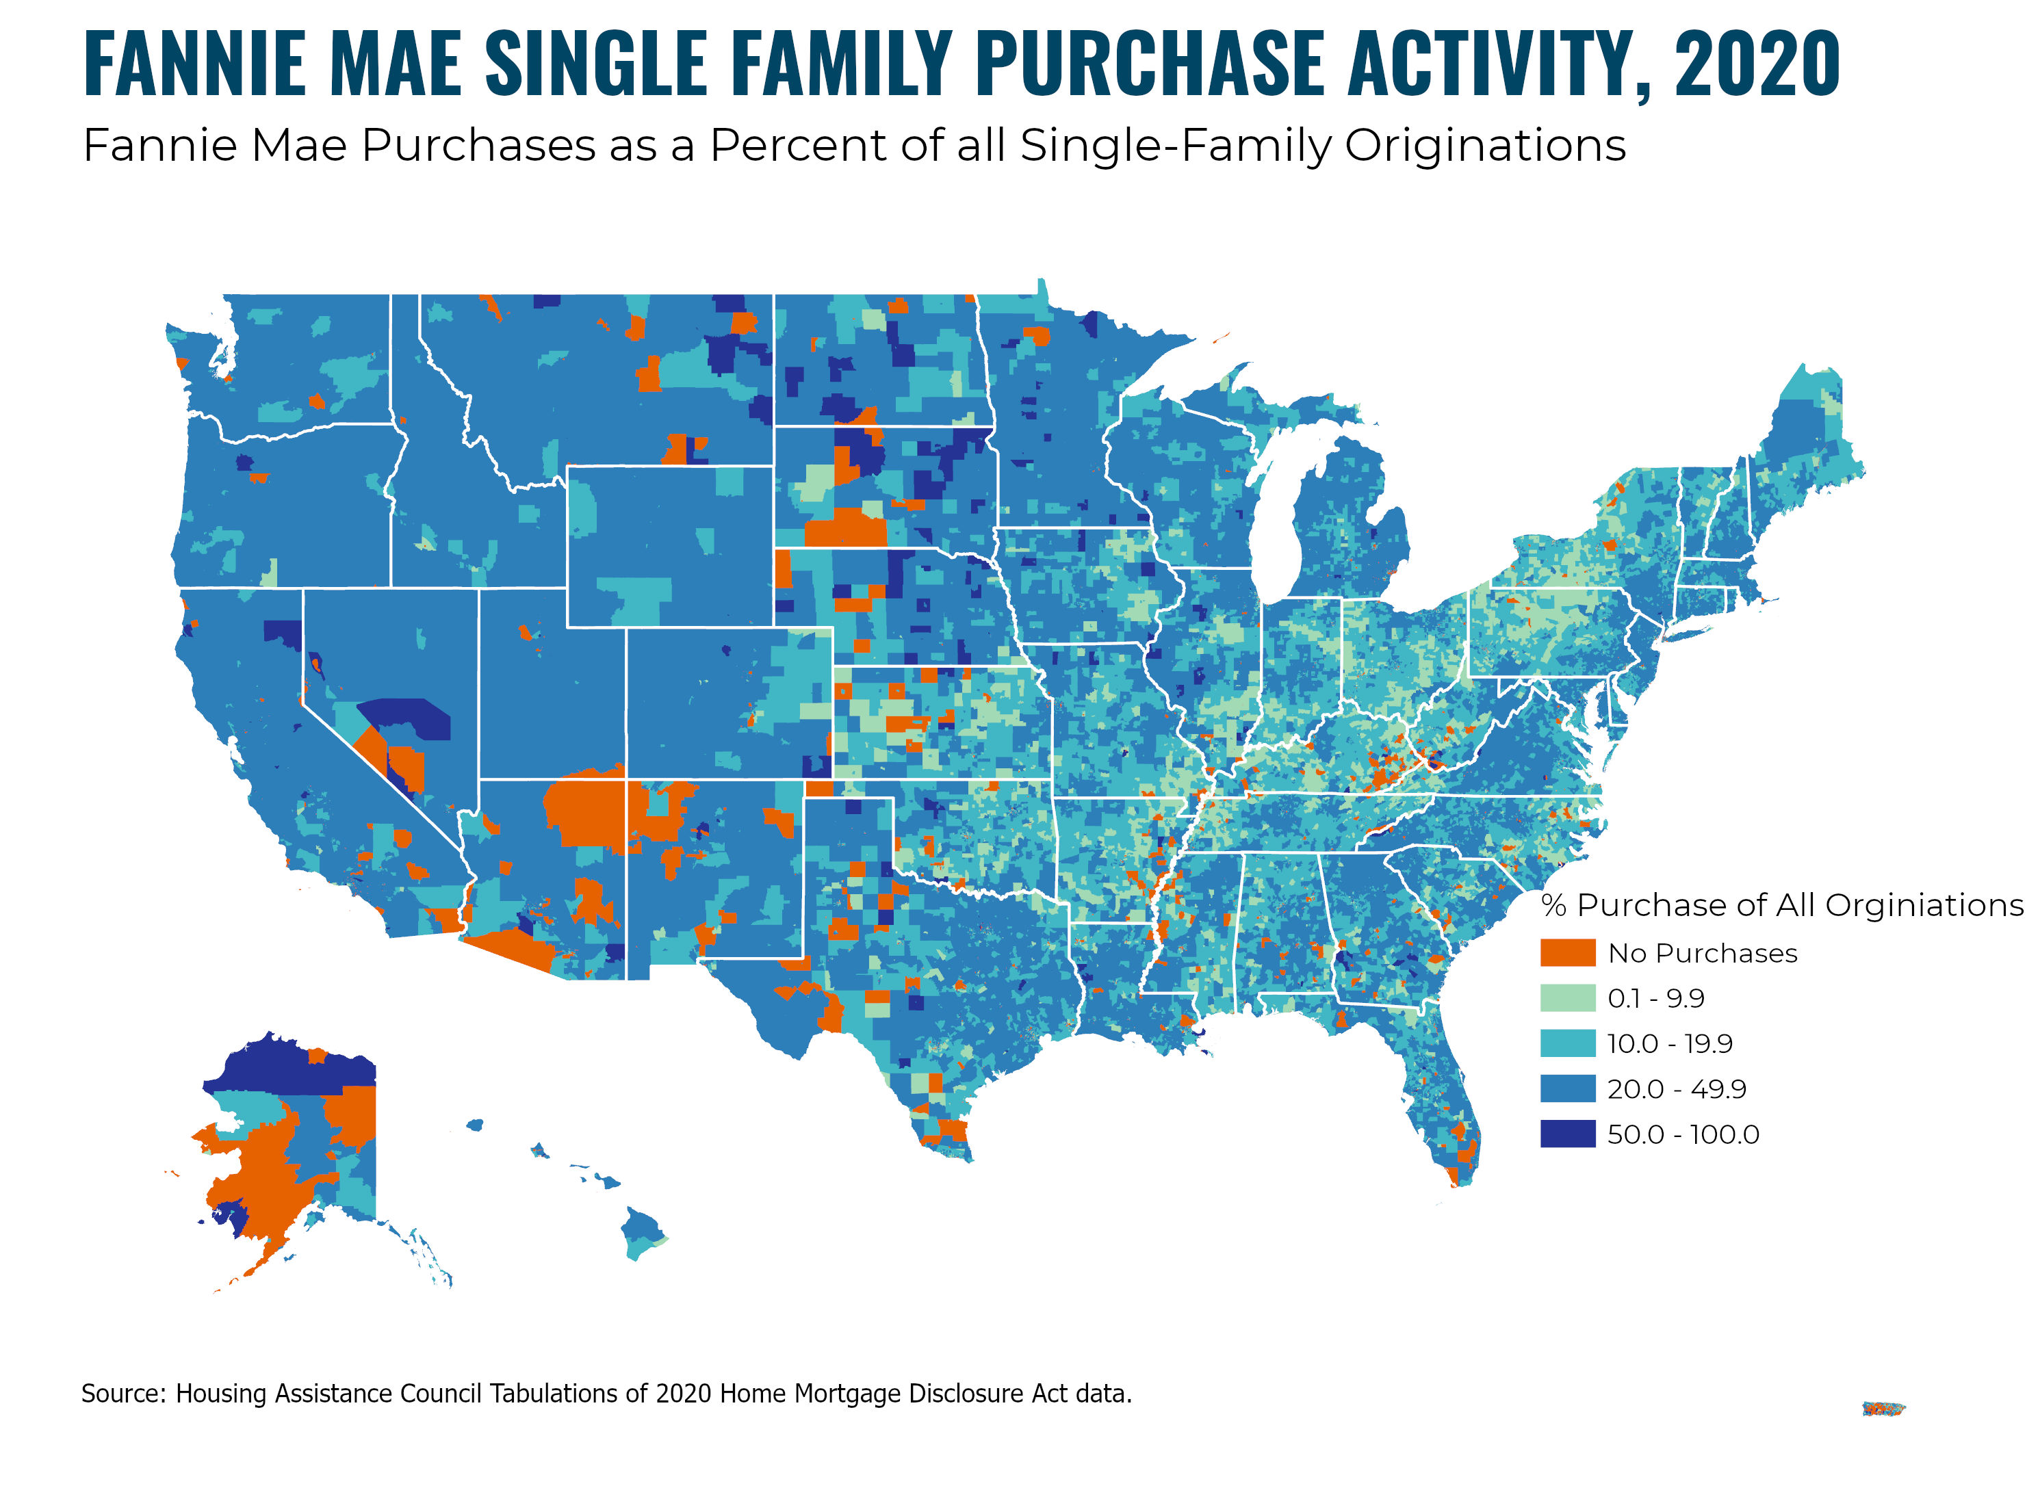

Slide 7
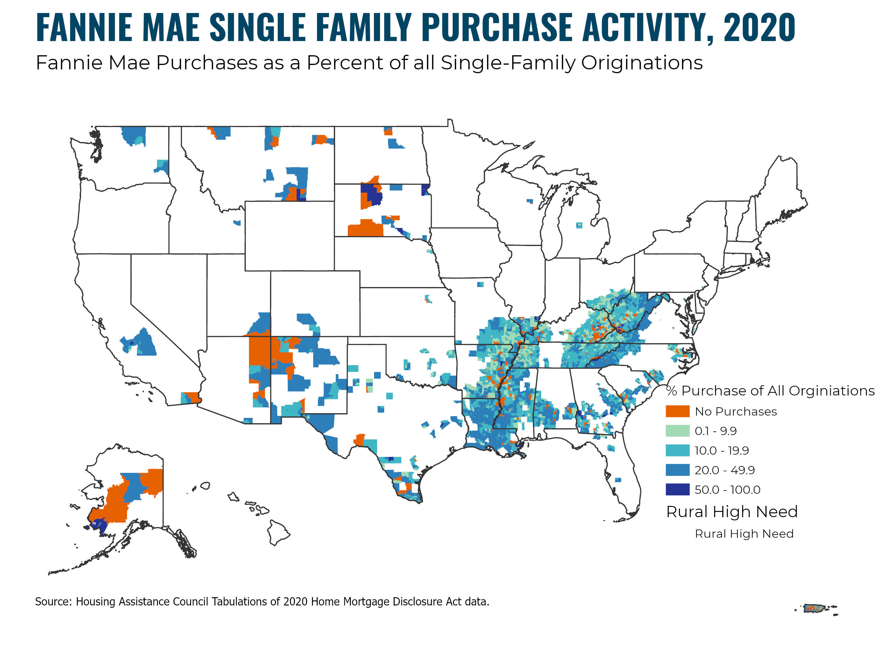

Slide 8
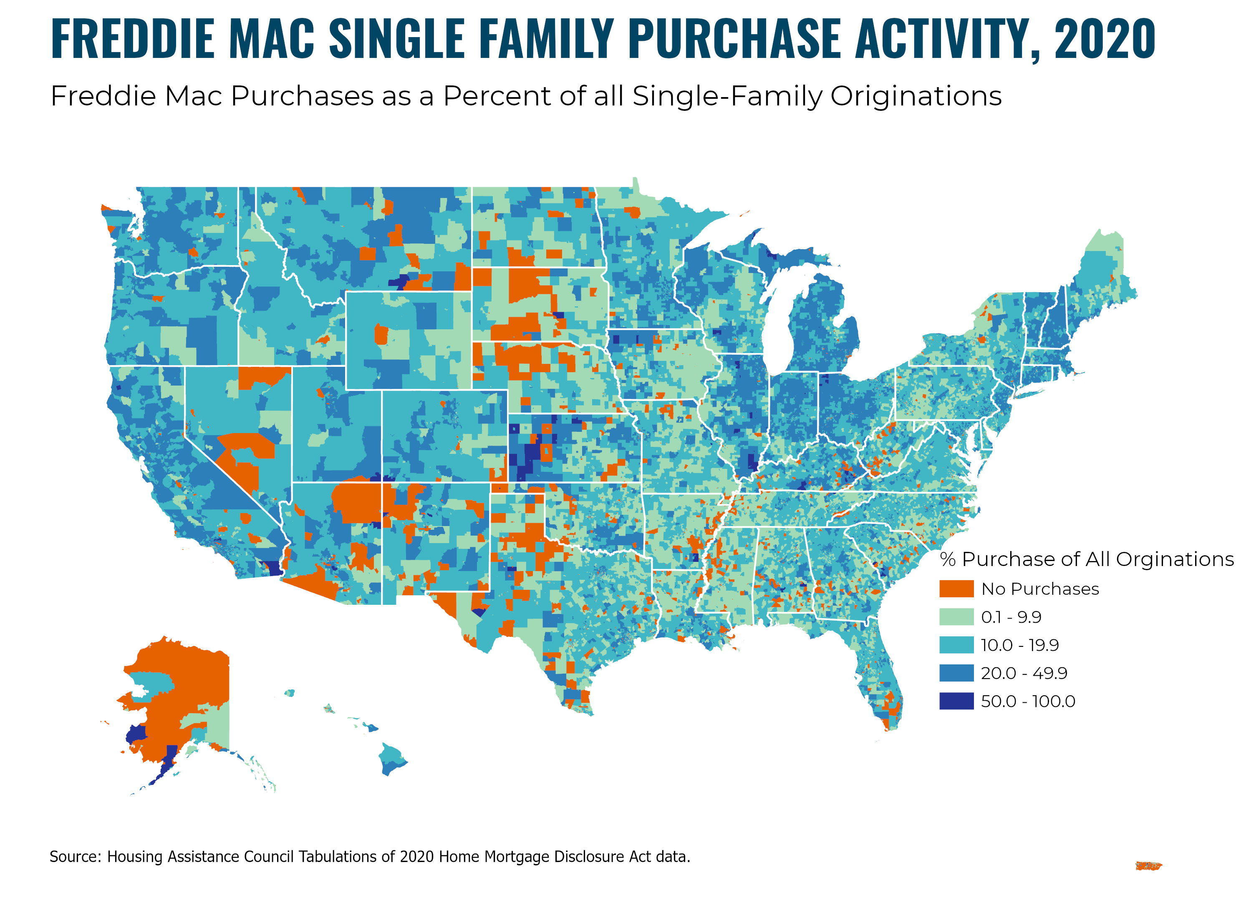

Slide 9
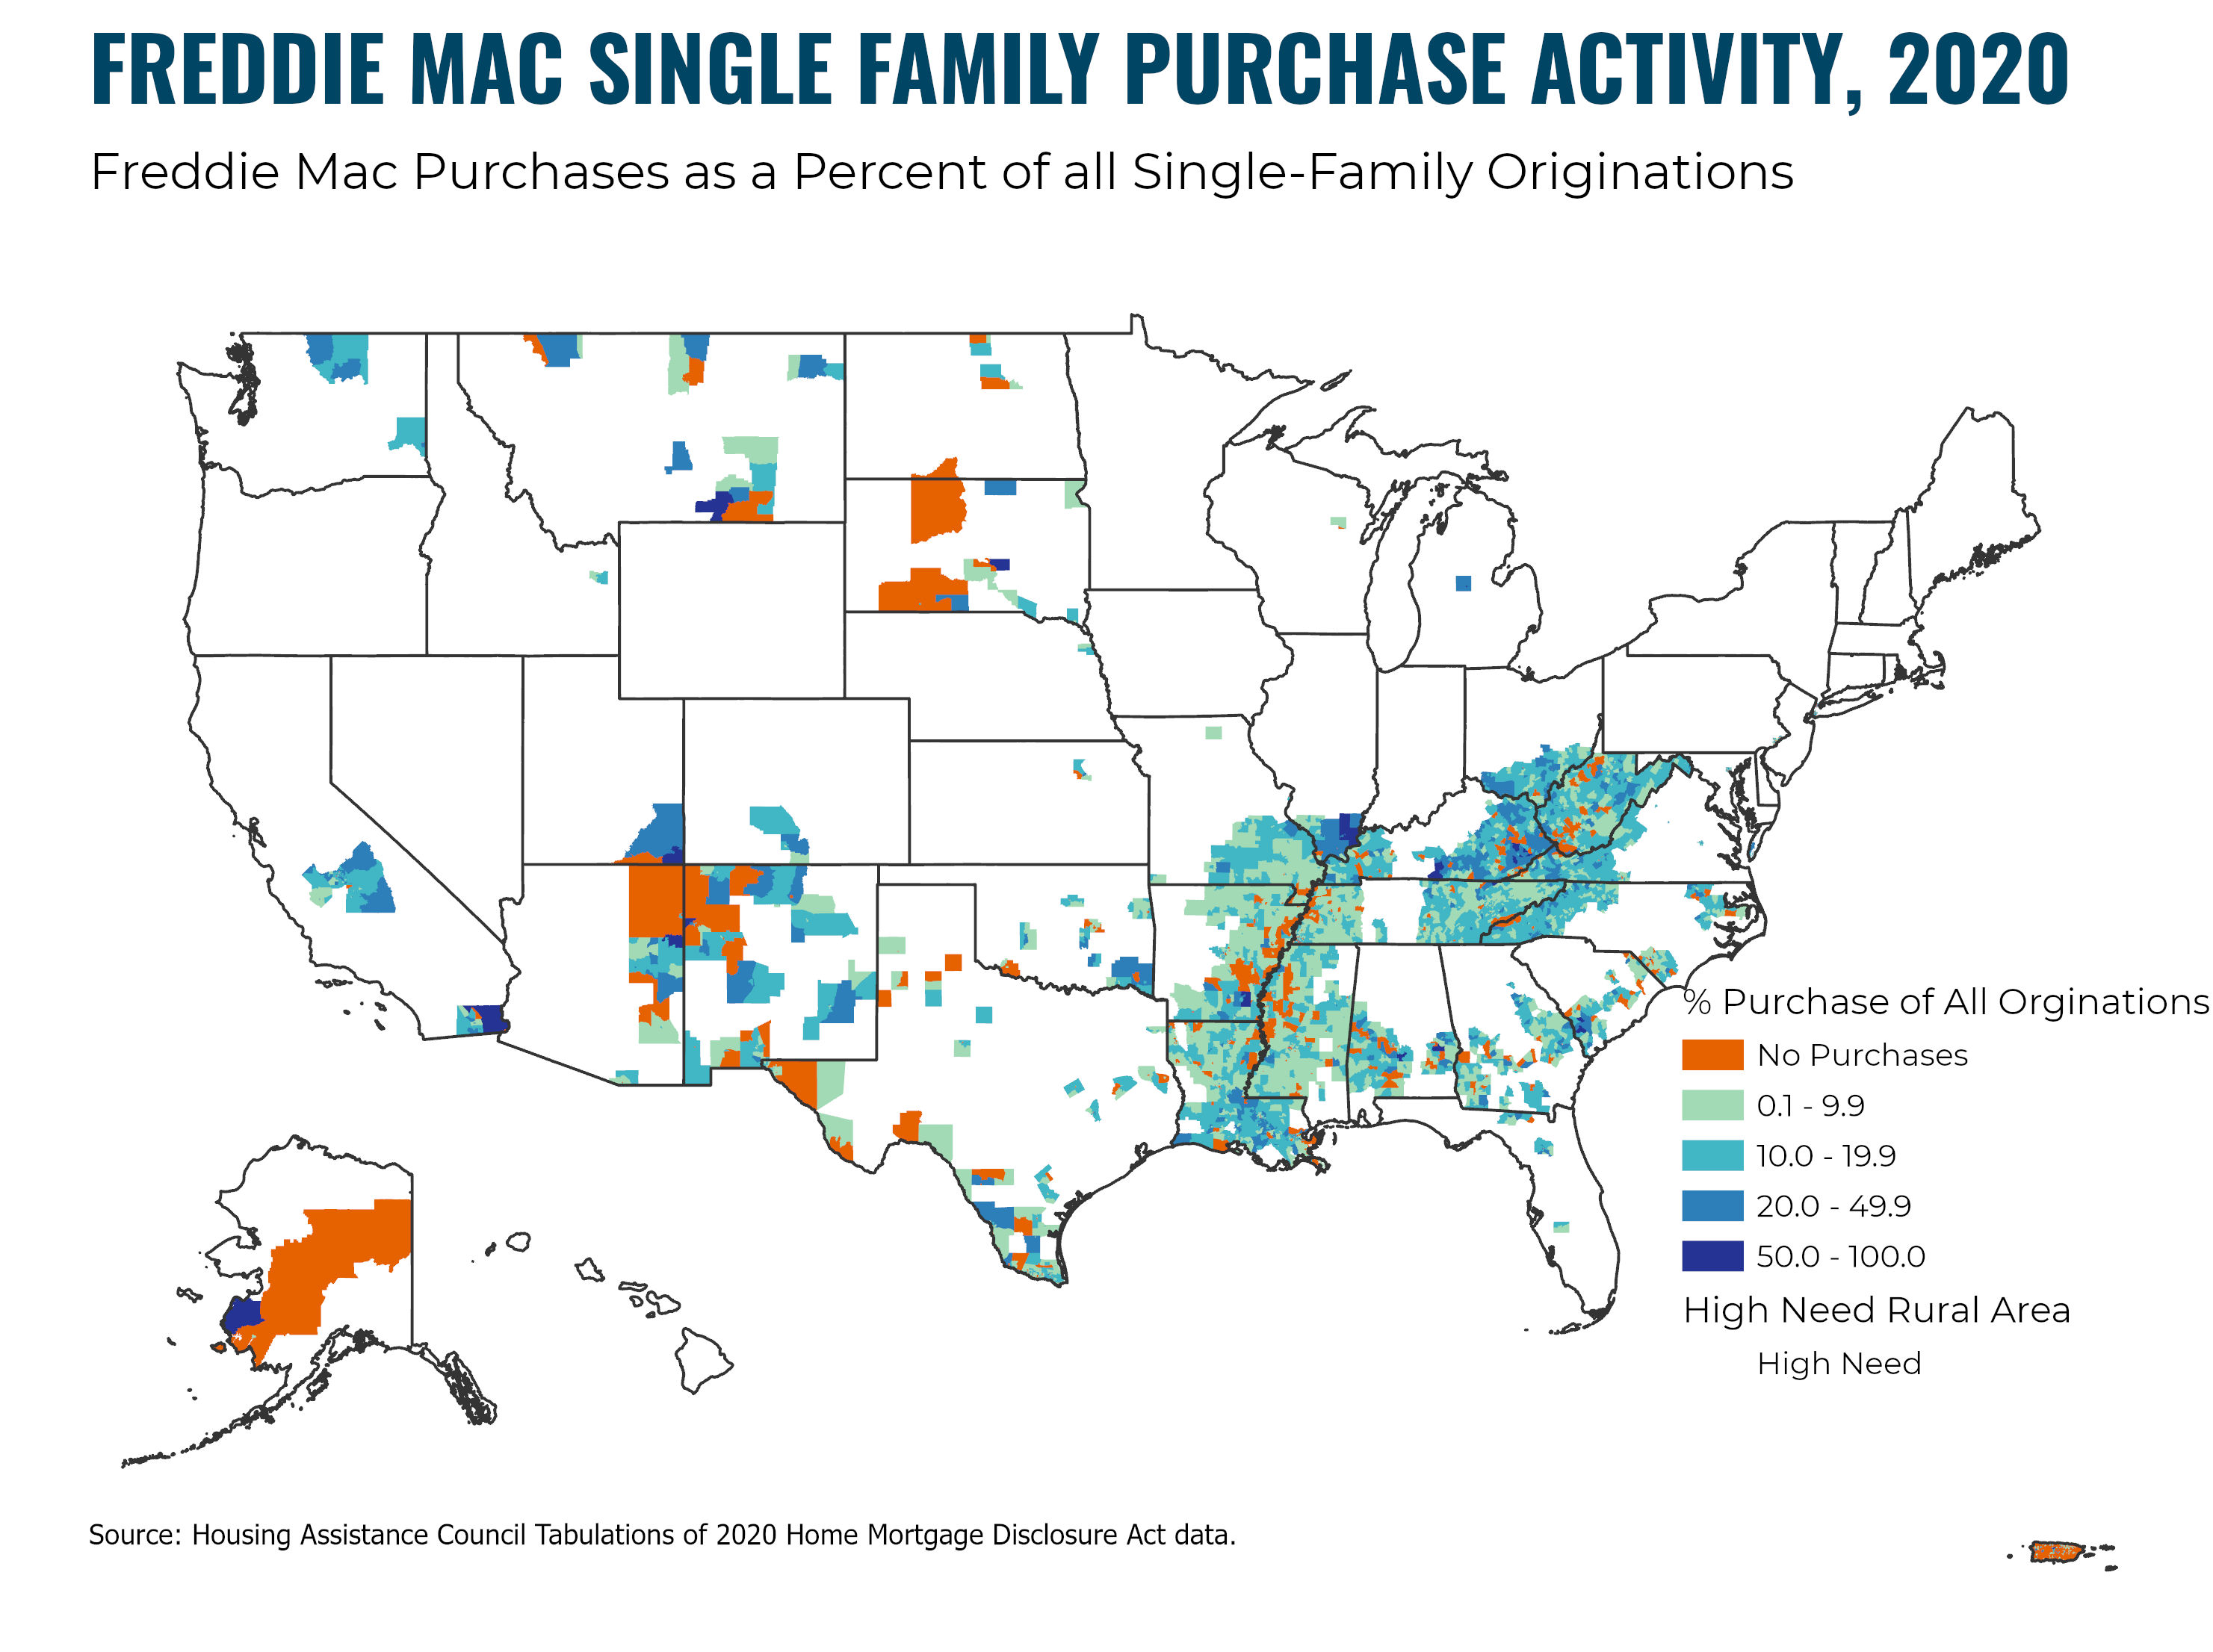

Slide 10
Where Do We Go From Here?

Slide 11
www.ruralhome.org

